Slide 1
REPRODUCTION PROCESS OF LIVING ORGANISMS

Slide 2
THROUGHLINE: HOW DOES REPRODUCTION OCCUR AT THE DIFFERENT ORGANIZATION LEVELS?

Slide 3
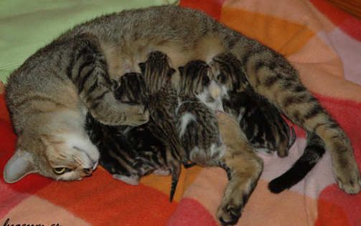
WHY DO ORGANISMS REPRODUCE?
Reproduction is a fundamental process of life in which an organism produces more organisms of the same kind to maintain the species.

Slide 4
A FORM OF REPRODUCTION IN WHICH GENETIC MATERIAL FROM TWO PARENT ORGANISMS IS COMBINED IN THE OFFSPRING.
USUALLY TWO HAPLOID GAMETES FUSE TO FORM A DIPLOID ZYGOTE.
SEXUAL REPRODUCTION

Slide 5
THERE ARE DIFFERENT KINDSOF CELLS
SOMATIC CELLS
They are cells specialized in making tissues
They are diploid, it means, they have two sets of chromosomes
GAMETES
They are cells specialized in reproduction. They are produced in organs called gonads.
They are haploid, it means, they have only one set of chromosomes

Slide 6
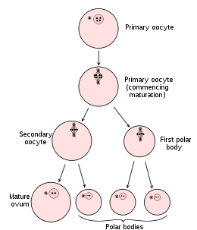
female organism
Has an organ called ovary that produces eggs.
An egg is a large non-motile haploid cell containing food reserves.

Slide 7
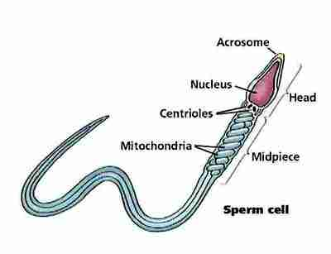
Male organism
Has a gonad called testis (plural: testes) that produces sperm.
Sperm are small motile haploid cells that have almost no cytoplasm and many mitochondria.

Slide 8
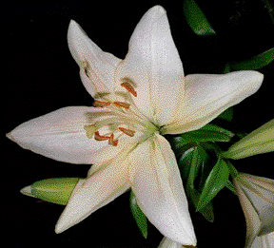
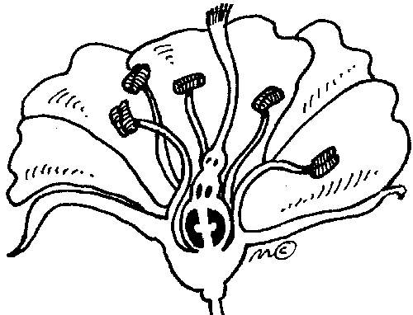
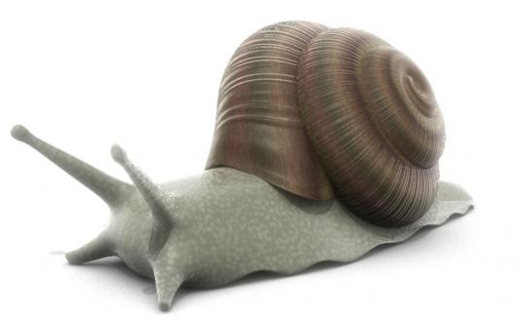
Hermaphrodite organism
Is an organism that produces both sperm and eggs in the same body.
Some of them engage for sex, some others self-fertilize their own eggs.

Slide 9
ADVANTAGES AND DISADVANTAGES OF SEXUAL REPRODUCTION
Advantages:
Genetic variation (the ability of organisms to adapt over time). Due to the fusing of gametes (one from each parent), the offspring displays a mixture of traits.
Two parents are required.
Disadvantages:
Energy must be consumed to find a suitable mate.
Mutations may occur
Not as rapid and efficient as other forms of reproduction
Very few offspring produced at a time

Slide 10
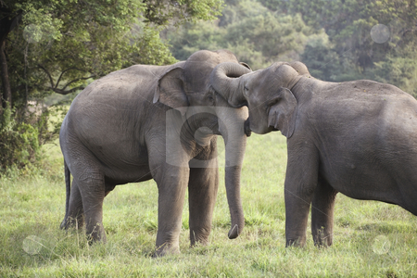
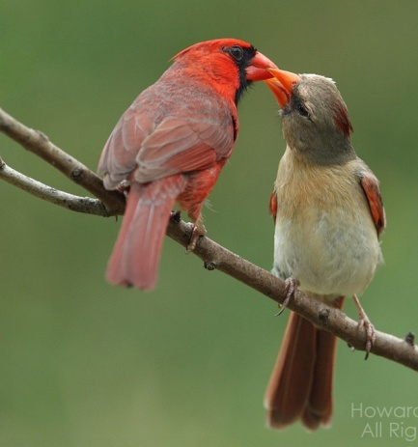
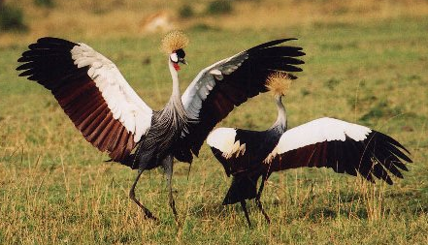
Fertilization: Is the union of sperm and egg to form a diploid zygote.
Some signs are sending for organisms to reproduce.
Visual, acoustic or chemical signs (pheromones) are sent when females are ovulating
Courtship behavior: Special ritual carried out before fertilization.

Slide 11
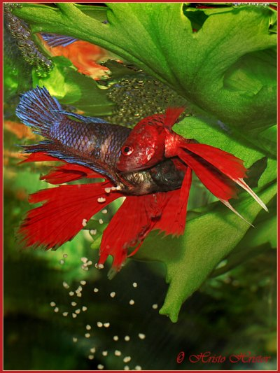
External fertilization
Occurs outside the body of the parents.
Synchronization of space and time.
Spawning: External fertilization into water.

Slide 12
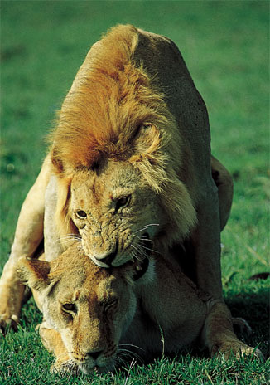
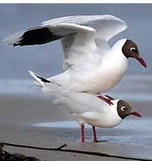
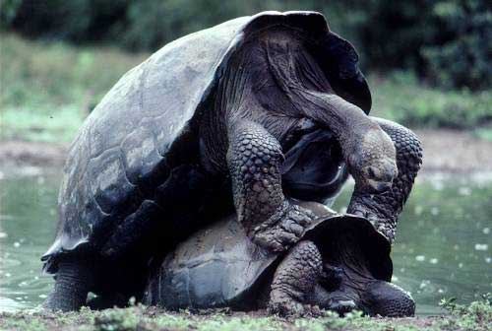
Internal fertilization
Occurs inside the female moist reproductive tract. Specially terrestrial organisms.
Copulation: Process in which male deposits sperm inside the female’s reproductive tract.
Some organisms do not copulate, so they use a Spermatophore: Sperm carrier

Slide 13
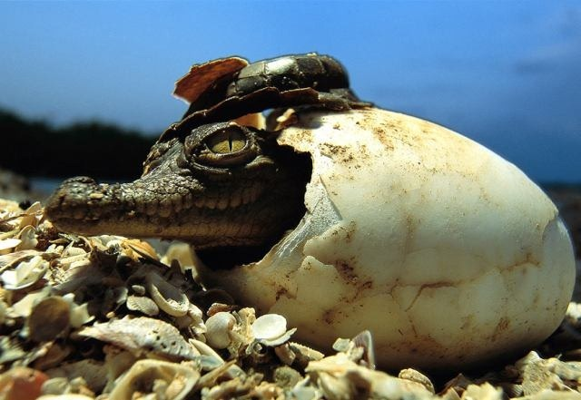
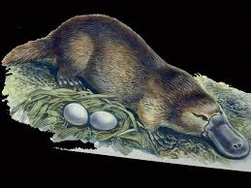
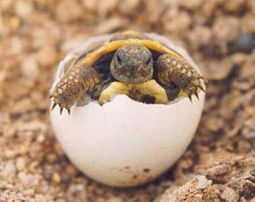
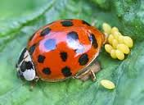
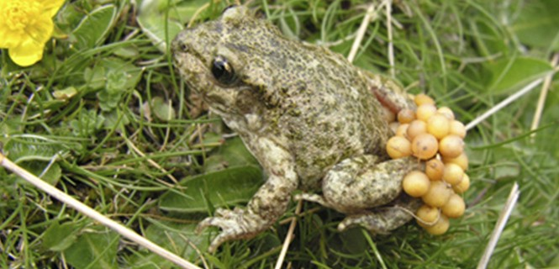
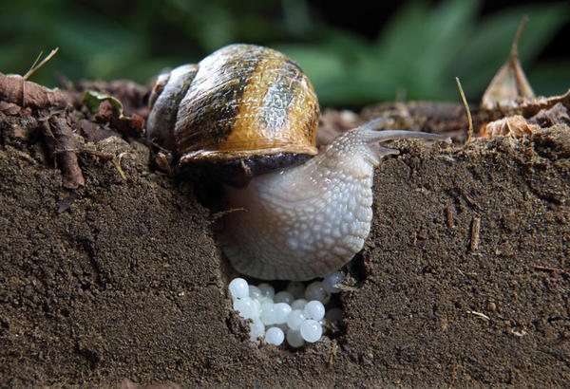
DEVELOPMENT OF EMBRYOS
OVIPAROUS: Are organisms that develop inside of an egg out of the parent’s body.

Slide 14
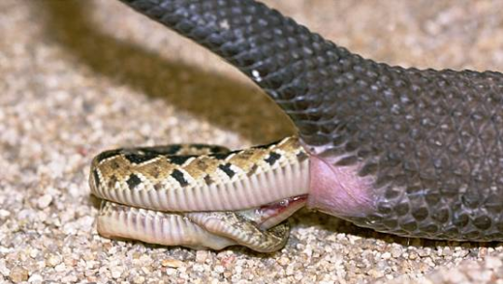
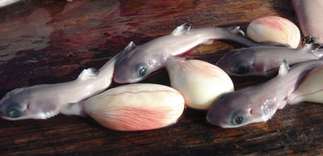
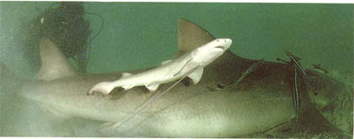
OVOVIVIPAROUS: Are organisms that develop inside of the mother’s body, but depend on the egg to obtain nutrients. They hatch inside of the mother’s body, and then, they are released.

Slide 15
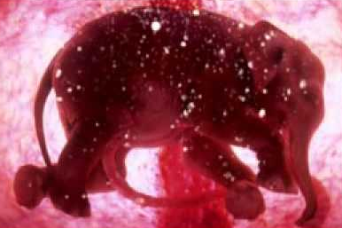
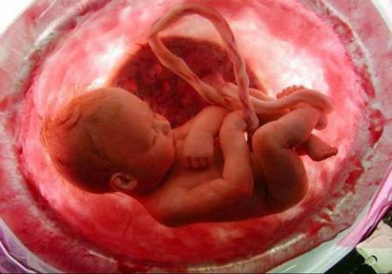
VIVIPAROUS: Are organisms that obtain nutrients directly from the body of the mother. Some of them obtain nutrients produced in the reproductive tract. In placental mammals, a special organ called placenta connects the circulatory systems of the embryo and the mother providing nutrients and facilitating excretion.

Slide 16
Cell division
WHY DO CELLS DIVIDE?
Cell division is the splitting of a single cell into two cells. This process accounts for three essential processes:
GROWTH
REPAIR
REPRODUCTION

Slide 17
THE CELL CYCLE
The cell cycle is the period from the beginning of one division to the beginning of the next cell division.
It has two parts:
Growth and preparation (interphase)
Cell division (nuclear division and cytokinesis)

Slide 18
INTERPHASE
Is the longest part of the Cell cycle. It is divided into three stages:
G1: Gap 1. Is a stage of growth and development.
S: Synthesis. Is the moment in which the cell becomes committed to cell division. During this stage, chromosomes in the nucleus replicate.
G2: Gap 2. The cell synthesizes organelles and other materials.

Slide 19
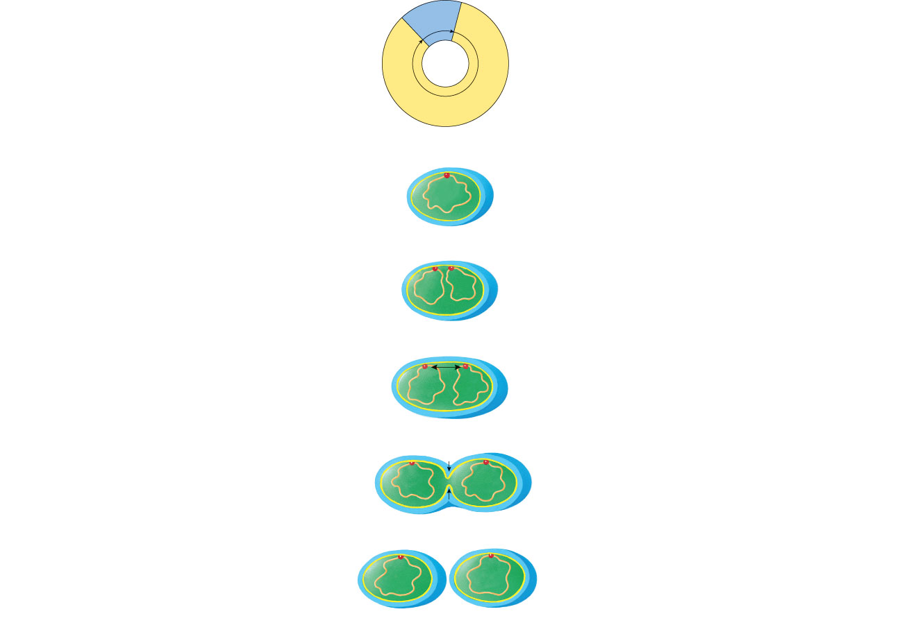
PROKARYOTIC CELL CYCLE
(a) The prokaryotic cell cycle
cell division
by binary
fission
cell growth and
DNA replication
(b) Binary fission
New plasma membrane is added between
the attachment points, pushing them farther apart.
attachment site
cell
wall
plasma
membrane
circular
DNA
The circular DNA double helix is attached to
the plasma membrane at one point.
The plasma membrane grows inward at the
middle of the cell.
The DNA replicates and the two DNA double
helices attach to the plasma membrane at nearby
points.
The parent cell divides into two daughter cells.

Slide 20
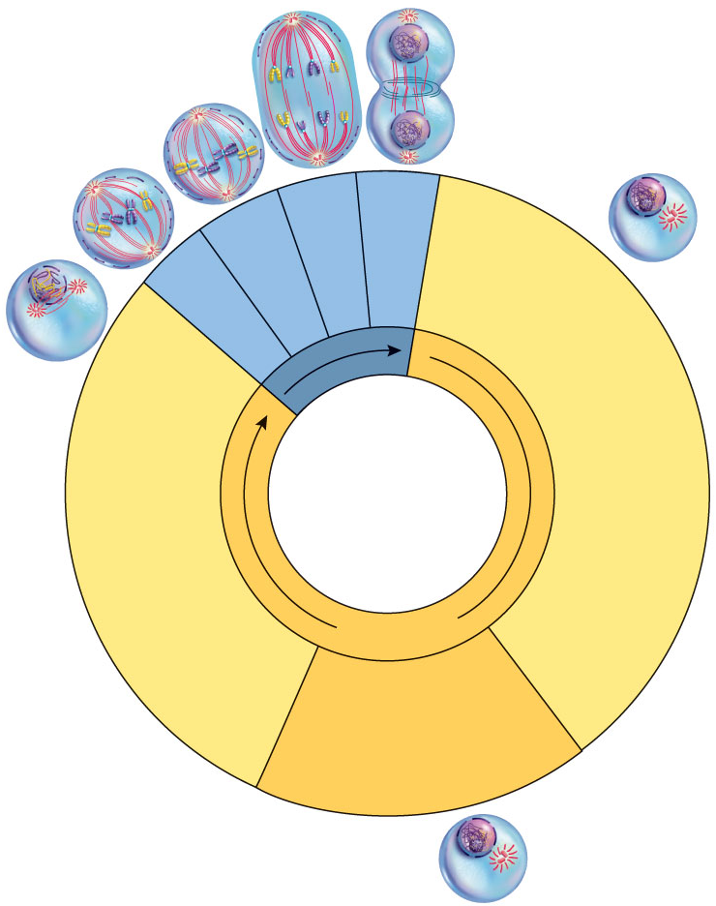
EUKARYOTIC CELL CYCLE
cytokinesis
anaphase
metaphase
telophase and
prophase
G₁: cell growth and
differentiation
nuclear
division
G₂: cell
growth
and
preparation
for cell
division
interphase
S: synthesis
of DNA;
chromosomes
are duplicated

Slide 21
NUCLEAR DIVISION
There are two kinds of nuclear division
MITOSIS (somatic cells)
MEIOSIS (gametes)
The nucleus divides into daughter nuclei containing identical sets of chromosomes.
A diploid cell produces two diploid cells.
Chromosomes replicate into sister chromatids
The nucleus divides into daughter nuclei containing different chromosomes.
A diploid cell produces two haploid cells.
Homologous pairs of chromosomes separate to form four haploid cells.

Slide 22
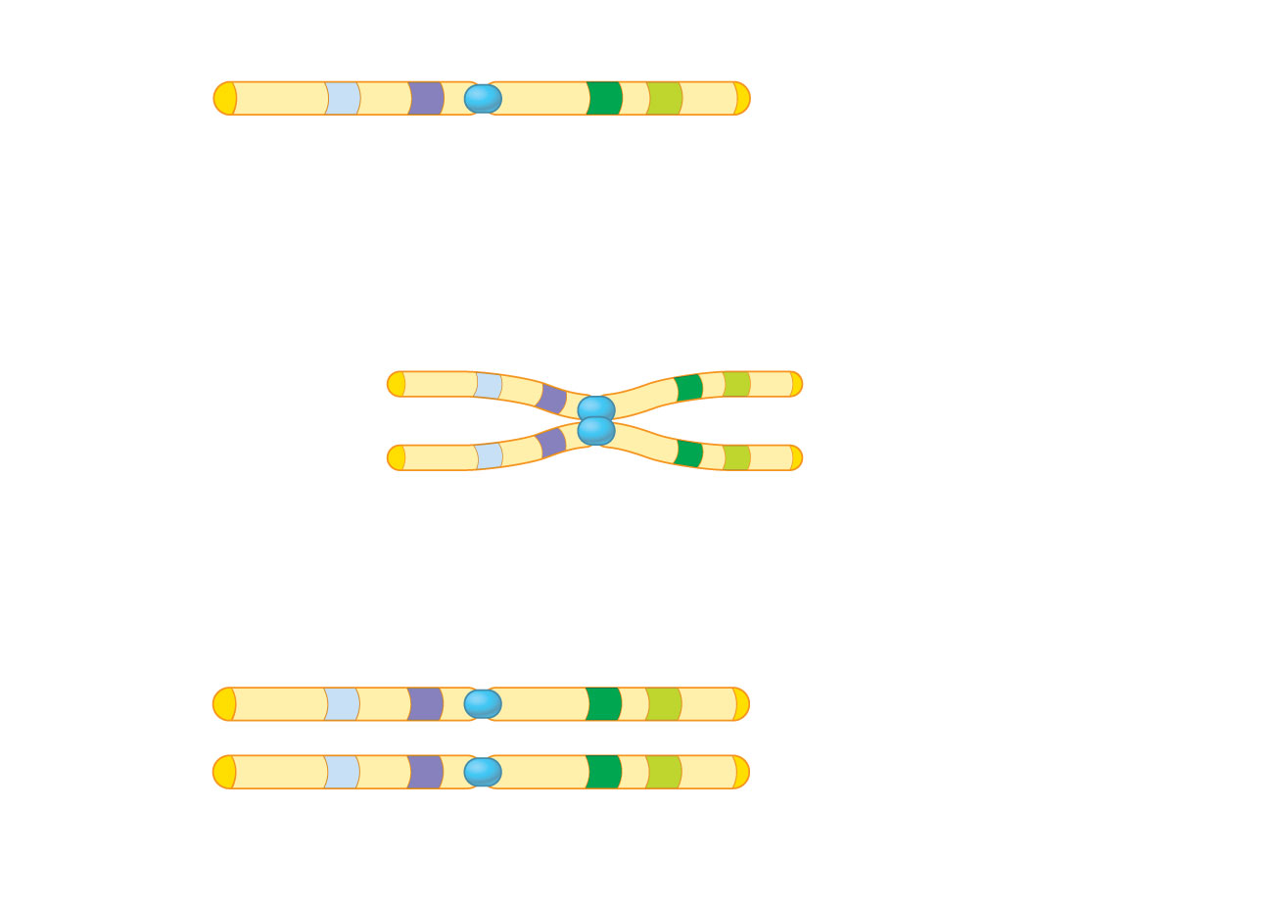
EUKARYOTIC CHROMOSOME
gene loci
centromere
telomeres
(a) A eukaryotic chromosome before DNA replication
duplicated
chromosome
(two DNA double
helices)
sister
chromatids
centromere
(b) A eukaryotic chromosome after DNA replication
independent
daughter
chromosomes,
each with one
identical DNA
double helix
(c) Separated sister chromatids become independent
chromosomes

Slide 23
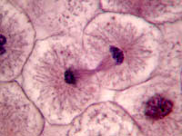
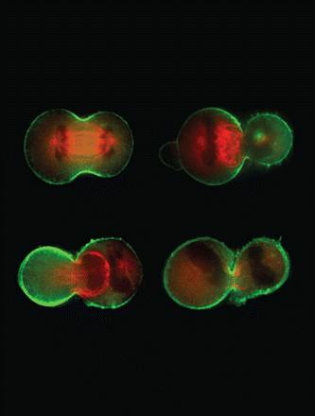
cytokinesis
Is the process in which cytoplasm divides to make two daughter cells.
In animal cells, the cell membrane at the center of the parent cell folds inward to form a cleavage furrow. Then, the cell is pinched in half until the membrane meets and forms a division in the middle.

Slide 24
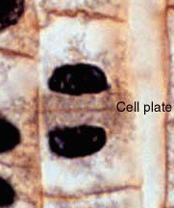
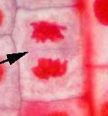
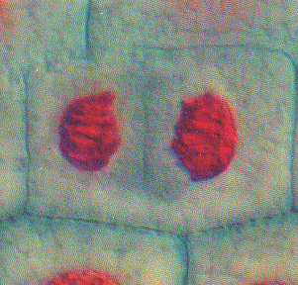
In plant cells, membrane-bounds accumulate and fuse to form a double membrane or cell plate that extends the lenght of the cell between the two new nuclei. A new cell wall forms between the membranes of the cell plate untill it divides the two daughter cells.

Slide 25
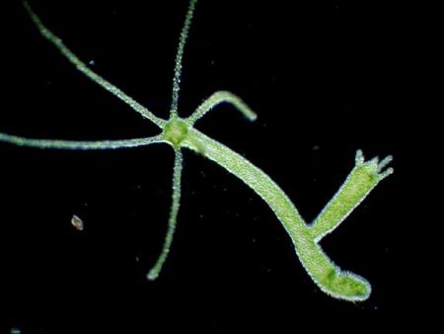
ASEXUAL REPRODUCTION
When offspring is produced by only one parent. Cell division replicates the chromosomes of only one parent cell, so offspring is genetically identical to their parent.

Slide 26
Advantages and Disadvantages of Asexual Reproduction
Advantages
Organisms that remain in one particular place and are unable to look for mates would need to reproduce asexually.
Numerous offspring can be produced without "costing" the parent a great amount of energy or time.
Environments that are stable and experience very little change are the best places for organisms that reproduce asexually.
Disadvantages
A disadvantage of this type of reproduction is the lack of genetic variation. All of the organisms are genetically identical and therefore share the same weaknesses. If the stable environment changes, the consequences could be deadly to all of the individuals.

Slide 27
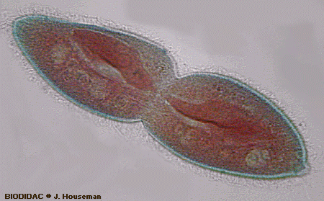
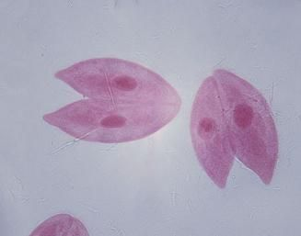
Asexual Reproduction in Other Organisms
Bacterial asexual reproduction most commonly occurs by a kind of cell division called binary fission. Since the cells produced through this type of reproduction are identical, they are all susceptible to the same types of antibiotics.

Slide 28
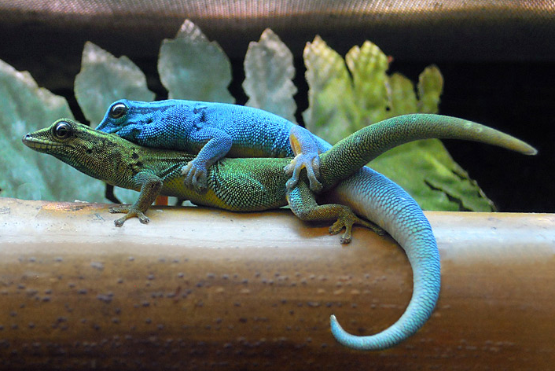
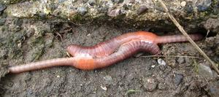
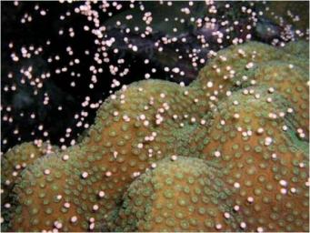
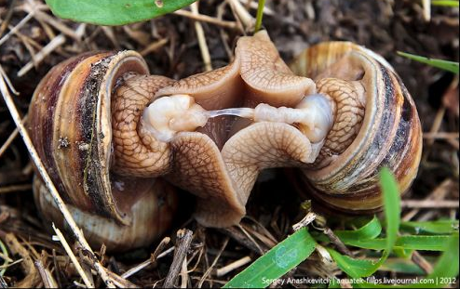
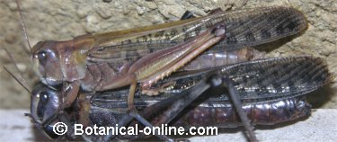
ASEXUAL REPRODUCTION IN ANIMALS
Most animals reproduce sexually, but some animals have the ability to reproduce asexually when they face special conditions, or in order to produce more offspring to keep the species.

Slide 29
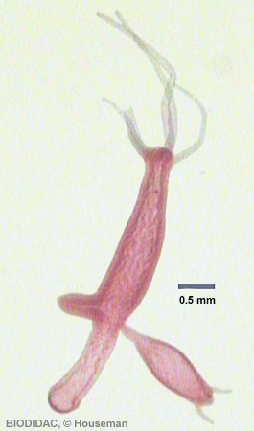
Some types of asexual reproduction are:
Budding
Offspring grows out of the body of the parent.
Example: Hydras

Slide 30
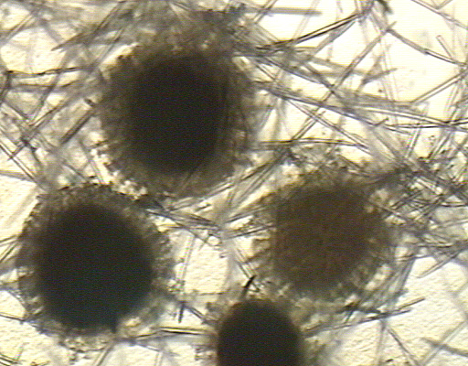
Gemmules (Internal Buds)
Parent releases a specialized mass of cells that can develop into offspring.
Example: Sponges.

Slide 31
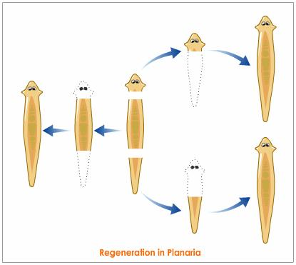
Fragmentation
The body of the parent breaks into distinct pieces, each of which can produce an offspring.
Example: Planarians

Slide 32
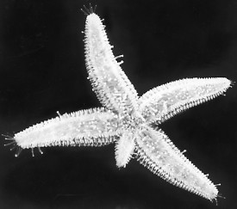
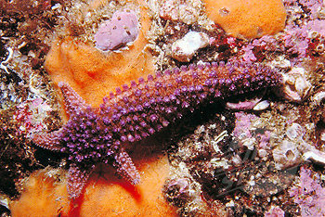
Regeneration
In regeneration, if a piece of a parent is detached, it can grow and develop into a completely new individual.
Example: Echinoderms

Slide 33
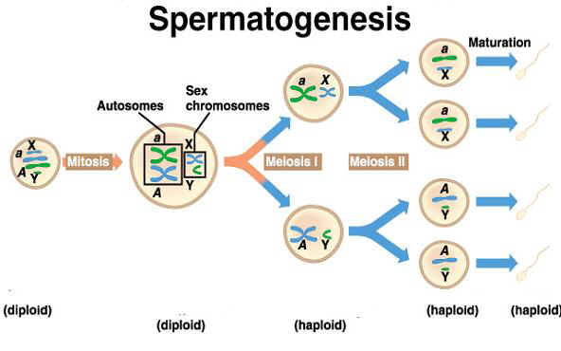
SPERMIOGENESIS: Formation of sperm cells.

Slide 34
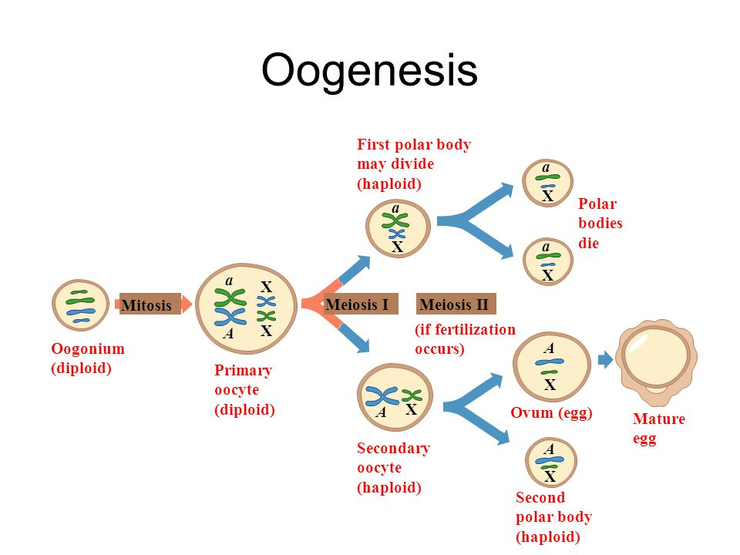
OOGENESIS: Formation of the egg.

Slide 35
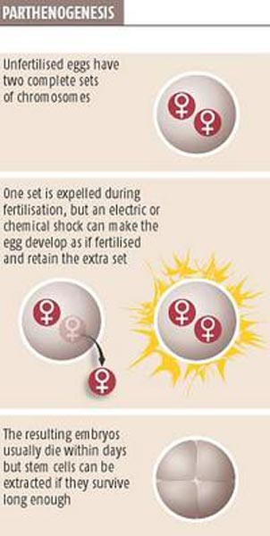
Parthenogenesis
This type of reproduction involves the development of an egg that has not been fertilized into an individual.
Animals like most kinds of wasps, bees, and ants reproduce by this process. Some reptiles and fish are also capable of reproducing in this manner.

Slide 36
KINDS OF PARTHENOGENESIS
According to frecquency:
Accidental Parthenogenesis: Individuals with sexual reproduction eventually have it.
Facultative parthenogenesis: When the ova can develop with or without fertilization.
Obligate parthenogenesis: Oocytes develop without fecundation because the species doesn’t have males.

Slide 37
According to the gender of the offspring:
Thelytoky: Produces only females.
Arrhenotoky: Produces only males.
Deuterotoky: Produces both genders.

