Slide 1
MOTION
SCIENCE SPECTRUM
PHYSICAL SCIENCE, 2006
HOLT, RINEHART
CHAPTER 10, SECTION 1.

Slide 2
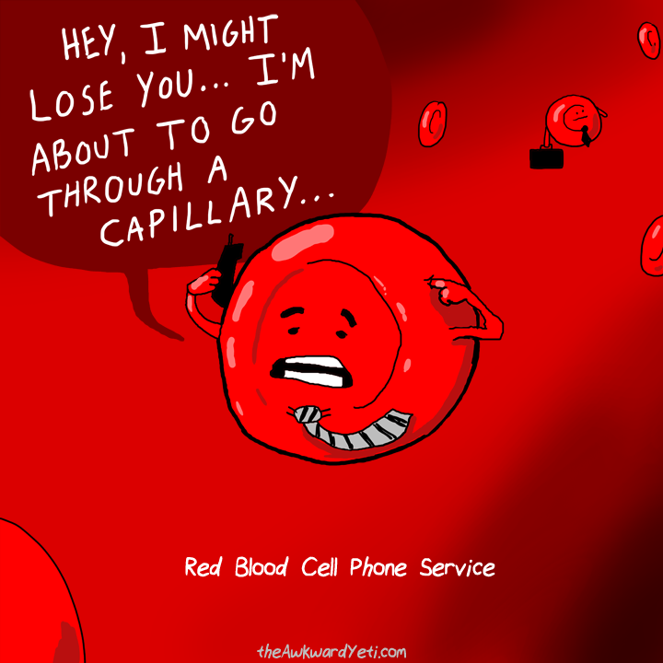





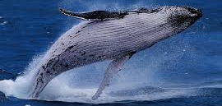
MOVING ON…

Slide 3

Motion + Frame of reference
Movement is the change of an object’s position relative to a reference point. A stationary object can be used as a reference point or frame of reference.

Slide 4
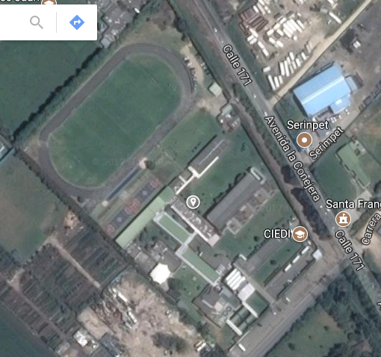
SCHOOL MAP

Slide 5
Use different colors to draw your pathway.
At 7:50, you arrive to school.
At 8:00, you are in your classroom.
At 8:10, you go to Arts room.
At 9:00, you go to Systems room.
At 9:50, you go to the Library.
At 10:40, you go to the store.
At 11:00, you go to the fields for PE.
At 11:50, you go to the Biology Laboratory.
At 12: 40, you go to the Cafetorium.

Slide 6
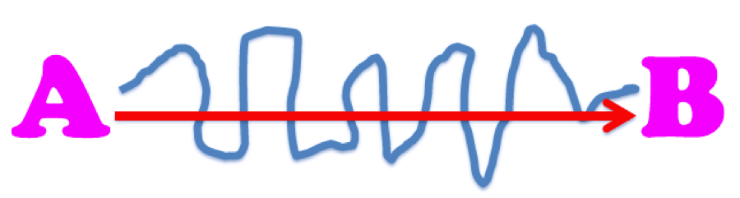
Distance vs. Displacement
Distance= How far an object moves or the path taken.
Displacement= Change in position of an object.

Slide 7
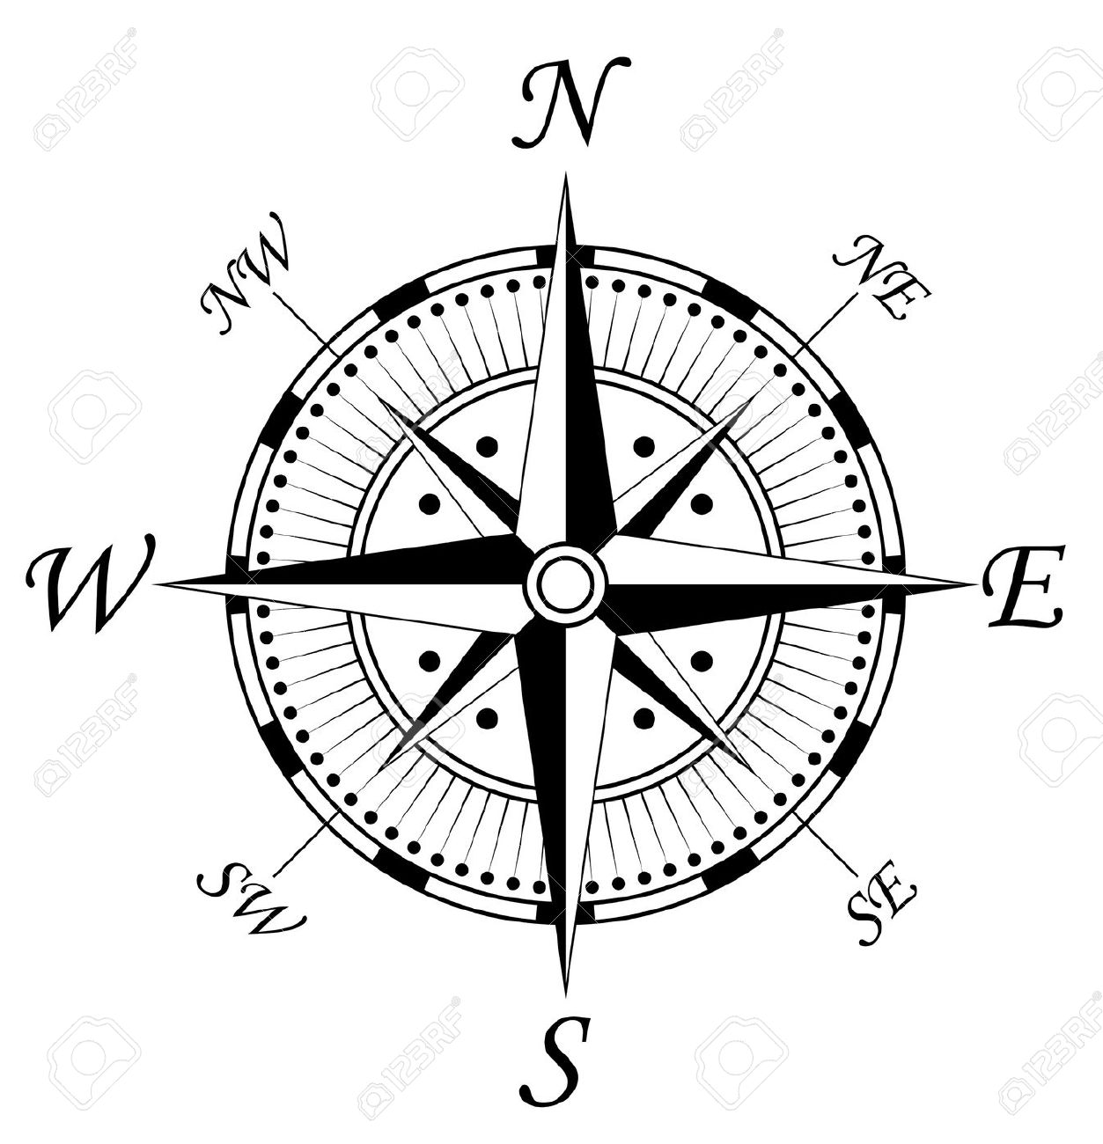
SPEED + VELOCITY
SPEED: The distance traveled divided by the time interval during which the motion occurred.
v=d/t
Speed is usually given in meters per second
VELOCITY: Is the speed of the object in motion and the direction.

Slide 8
Exercises
Find the velocity in m/s of a swimmer who swims 110 m towards the shore in 72 s.
Find the velocity of a baseball thrown 38 m from third base to first base in 1.7 s.
For several days in 1936, Alaska’s Black Rapids glacier surged as swiftly as 89 meters per day down the valley. Find the glacier’s velocity.
Calculate the displacement in meters a cyclist would travel in 5 h at an average velocity of 12 km/h to the southwest.

Slide 9
The marlin is one of the fastest fish in the ocean. Find the time taken by a marlin that has a speed of 36.11 km/h and swims a distance of 3500 meters.
A car travels at a speed of 40 kilometer per hour (km/h) for a time of 02 hours, 24 minutes and 50 seconds.
Find the velocity of a car that travels a distance of 70 miles during 1.24 hours.
A cheetah runs at a speed of 45 km/h during 10 minutes. How far did it go?
A harpy Eagle flies at 75 km/h through a distance of 2500 meters. Calculate the time.

Slide 10
Resultant velocity
Is the sum of two velocities.
Example:
A person walking at a speed of 1 m/s in a bus that goes at a velocity of 14 m/s west.
If the person goes west:
14 m/s west + 1 m/s west = 15 m/s west.
If the person goes east:
14 m/s west +(- 1 m/s east) = 13 m/s west.

Slide 11
Acceleration
Is the rate at which velocity (speed or direction) changes over time.
It can be calculated by dividing the average change in velocity by the time it occurs.

Slide 12
FORCE: Is an action exerted on a body to change its state of rest or motion.
FORCES
FRICTION
GRAVITY
NORMAL
RESISTANCE

