Slide 1
ENERGY

Slide 2
ENERGY: Is the ability of an object to do work.
FORCE: is a push or pull upon an object resulting from the object's interaction with another object. Force is measured in Newtons (N)
One Newton is the amount of force required to give a 1-kg mass an acceleration of 1 m/s²

Slide 3
FORCE: Is an action exerted on a body to change its state of rest or motion.
FORCES
FRICTION
GRAVITY
NORMAL
RESISTANCE

Slide 4
WORK: Is the transfer of energy to an object by the applying of a force that modifies its position or direction.
Work and energy are measured in joules. A joule is the relation between force (newtons) and distance (m)

Slide 5
A steady object seems to be motionless, however, it stores energy related on its shape, position or condition. This kind of energy is called Potential Energy.
As the object modifies its position, shape or condition, the potential energy turns into Kinetic energy.
The system of potential and kinetic energy is called Mechanical Energy.

Slide 6
HOW TO CALCULATE ENERGY?
First, let’s make some concepts clear…

Slide 7
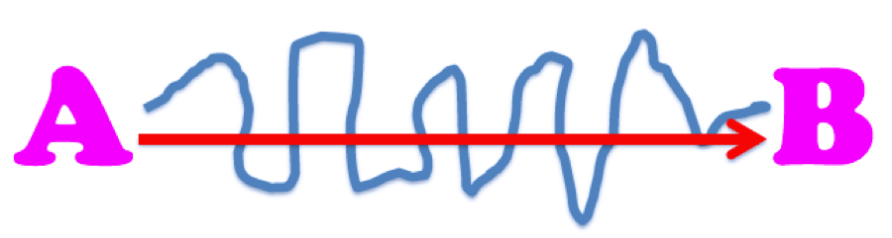
Distance vs. Displacement
Distance= How far an object moves or the path taken.
Displacement= Change in position of an object.

Slide 8
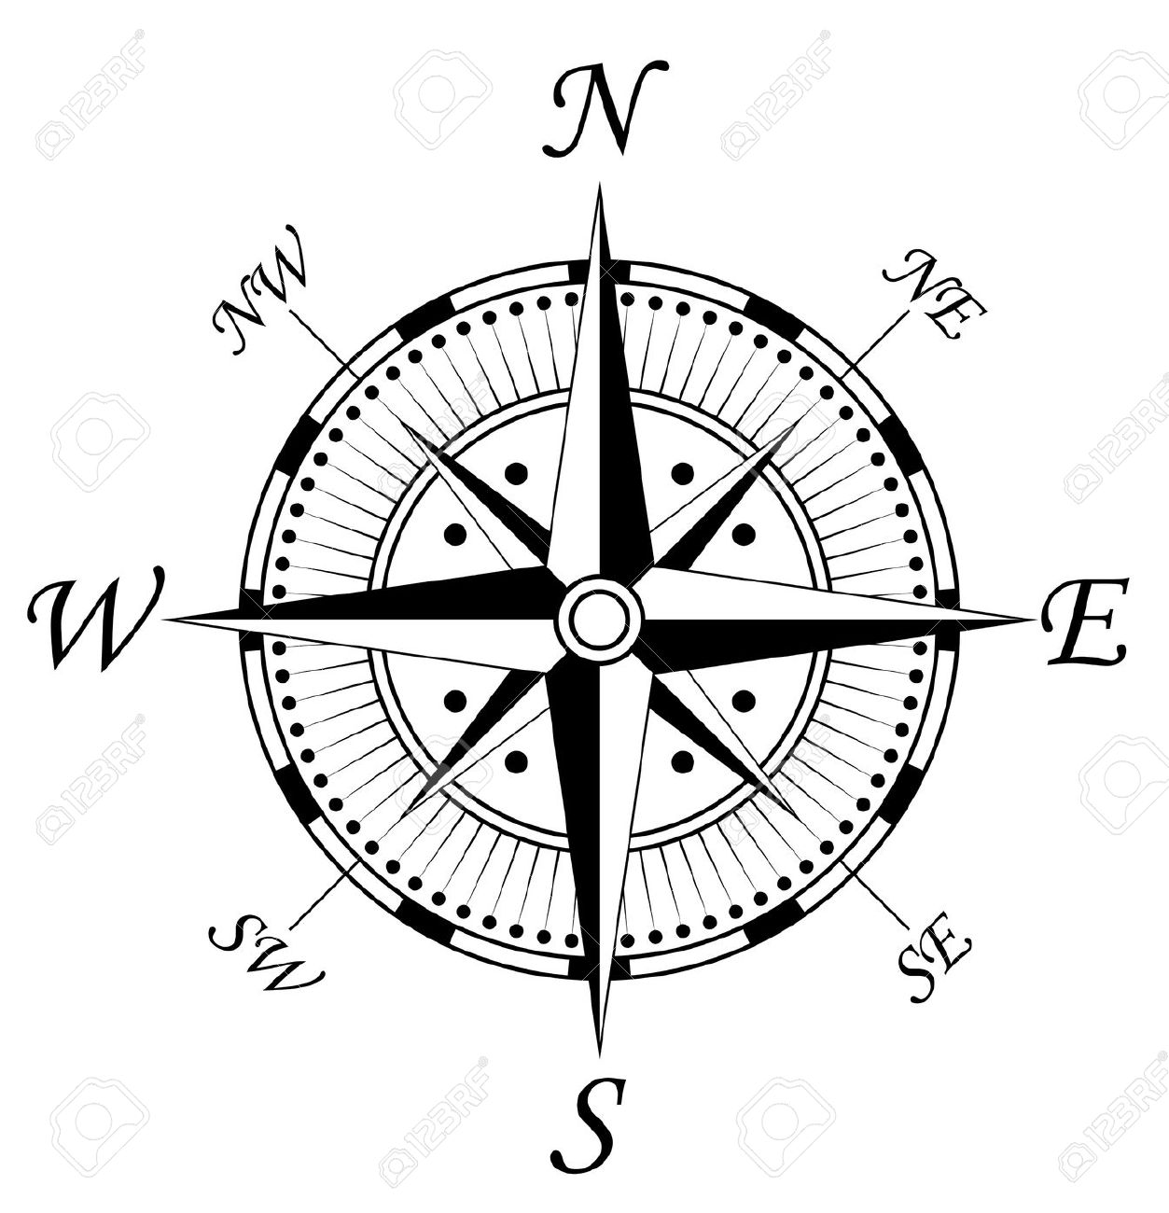
SPEED + VELOCITY
SPEED: The distance traveled divided by the time interval during which the motion occurred.
v=d/t
Speed is usually given in meters per second
VELOCITY: Is the speed of the object in motion and the direction.

Slide 9
Exercises
For several days in 1936, Alaska’s Black Rapids glacier surged as swiftly as 89 meters per day down the valley. Find the glacier’s velocity.
Find the velocity in m/s of a swimmer who swims 110 m towards the shore in 72 s.
Find the velocity of a baseball thrown 38 m from third base to first base in 1.7 s.
Calculate the displacement in meters a cyclist would travel in 5 h at an average velocity of 12 km/ to the southwest.

Slide 10
Resultant velocity
Is the sum of two velocities.
Example:
A person walking at a speed of 1 m/s in a bus that goes at a velocity of 14 m/s west.
If the person goes west:
14 m/s west + 1 m/s west = 15 m/s west.
If the person goes east:
14 m/s west +(- 1 m/s east) = 13 m/s west.

Slide 11
Acceleration
Is the rate at which velocity (speed or direction) changes over time.
It can be calculated by dividing the average change in velocity by the time it occurs.

Slide 12
How to calculate the gravitational potential energy of an object?
It depends on the mass of the object, the acceleration of gravity, that is given as 9,8 m/s², and the height of the object.
P^{E}=mgh

Slide 13
HOW TO FIND MASS AND HEIGHT?
We have to move the terms:
h=P^{E}/mg
m=P^{E}/hg

Slide 14
EXERCISES
A 65 Kg climber ascends a cliff. What is the climber’s gravitational energy at a point 35m above the base of the cliff?
A car with a mass of 1200 Kg at the top of a 42 m high hill. Find the potential gravitational energy of the car.
A 4,3 Kg bird flying at an altitude of 550 m. Find the potential gravitational energy of the bird.
A science student holds a 56 g egg out a window. Just before the student releases the egg, it has 8.0 J of gravitational potential energy with respect to the ground. How far is the student’s arm from the ground in meters?
A diver has 3400 J of gravitational potential energy after stepping up onto a platform that is 6 m above the water. What is the diver’s mass in kilograms?

Slide 15
How to calculate the Kinetic energy of an object?
Kinetic energy depends on the mass of the object and its speed.
To obtain the value, you must multiply half of the mass times speed squared:
K^{E}=1/2mv²

Slide 16
How to find mass or speed?
We have to move the terms:
V²=2K^{E}/m
m=2K^{E}/V²

Slide 17
EXERCISES
What is the kinetic energy of a 44 kg cheetah running at 31 m/s?
Calculate the kinetic energy of a 1500 Kg car moving at 29 m/s, 42 m/s and 18 m/s.
A 35 Kg child has 190 J of kinetic energy after sledding down a hill. What is the child’s speed in meters per second at the bottom of the hill?
A bowling ball traveling 2 m/s has 16 J of kinetic energy. What is the mass of the ball in kilograms?

Slide 18
NONMECHANICAL ENERGY
Particles of matter are in constant motion. This energy is transferred through collisions.
The average energy of particles increases with heat and decreases with cold.
Energy in molecules changes according to the chemical bonds involved in chemical reactions. This kind of energy is chemical energy.

Slide 19
Plants use photosynthesis to turn the energy from the Sun into chemical energy. This energy is transferred from one organism to another in the food chain.
Each time you eat, you are storing chemical energy that you use each time you breathe. When you move, you need oxygen to power the chemical reactions in your body that provide energy.

Slide 20
Waves can transport energy such as light and sound.
Nuclear energy is produced when nuclei of atoms react turning heavier (fusion) or when a heavy nucleus is split in two lighter nuclei (fission)
Electricity is produced by the flow of charged particles through wires or other conducting materials.

Slide 21
CONSERVATION OF ENERGY
Energy is not created or destroyed. It is transformed.
Potential energy turns into kinetic energy and vice versa.
Energy can be shown as heat, light, electricity or movement.

