Slide 1
Arts and Science
The history of the study of the human body in drawings
Thanks to Google Images

Slide 2
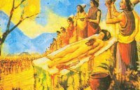
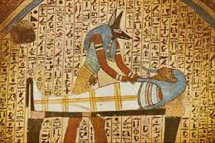
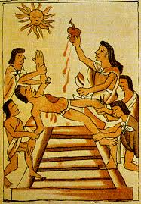
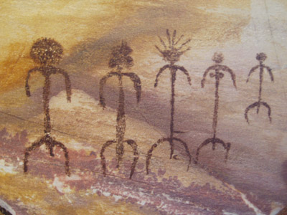
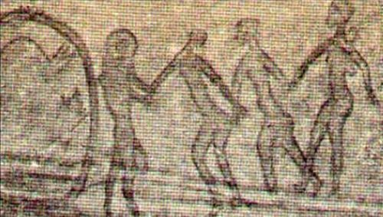
Around the world, many different civilizations used nature as a source of medicine and learned how to prepare corpses for funerals and identified some organs through mystical rituals such as offers and sacrifices.

Slide 3
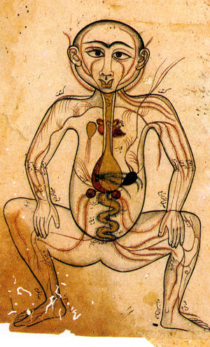
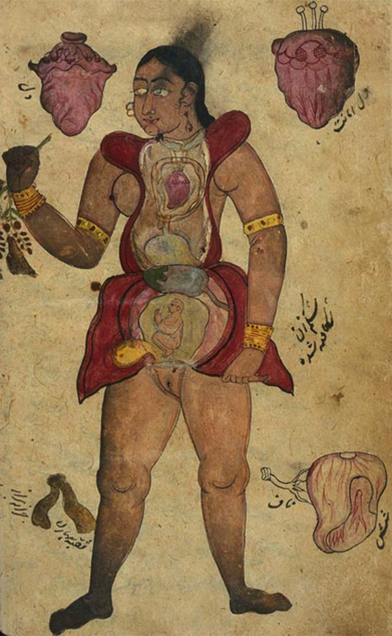
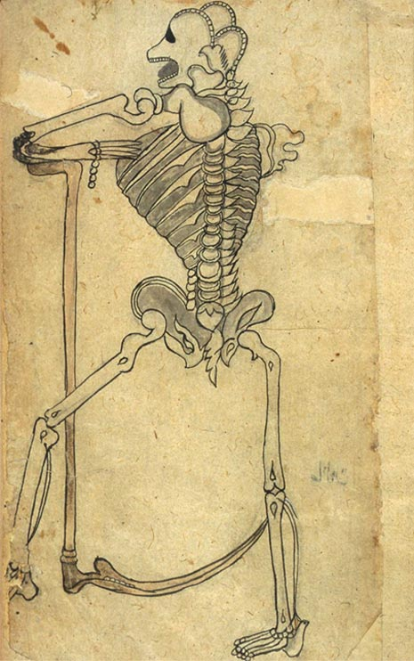
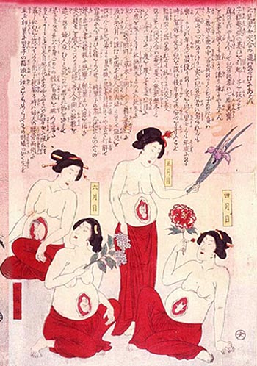
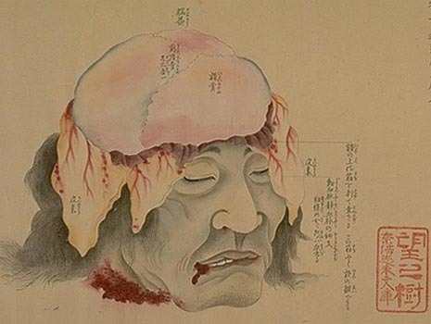
Many Asian cultures were interested on the human body and medicine, so they developed different treatments and processes to study the internal structure of humans through the dissection of corpses from the wars. There are still many drawings and manuscripts related to anatomy made with different ink colors and techniques.

Slide 4
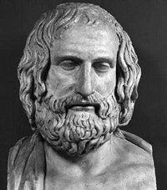
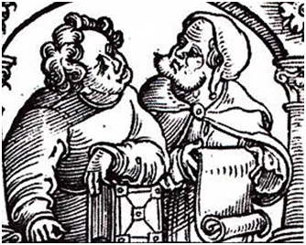
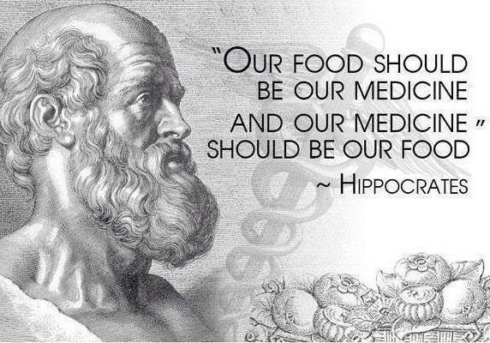
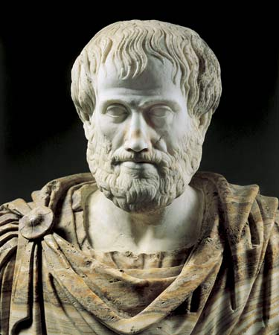
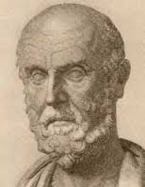
WESTERN CULTURES (V Century BC)
Greeks and romans documented human dissections and identified structures such as veins, arteries, nerves, tendons, and of course, organs. The word Anatomy comes from the greek word for cut. Many of them wrote treatises and made diagrams of compared anatomy by using animal corpses, and based on them, they wrote books explaining the procedure, but as they were more theoretical, many mistakes were settled as theories, even for centuries. Many of them were destroyed during the Bizantine period. Some of them were preserved in the Alexandria Library.
Empedocles
Herophilus Erasistratus
Alcmaeon
Aristotle

Slide 5
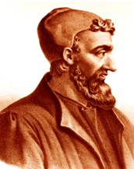
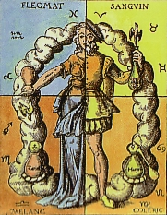
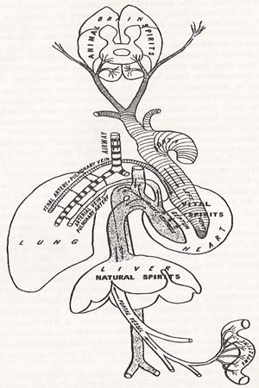
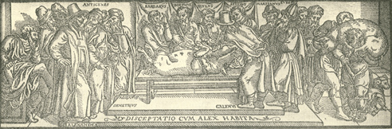
Claudius Galen. The authority of medicine for centuries
(131 – 201 BC) Galen wrote more than 130 medical treatises based on compared anatomy and some philosophers, and his medicine was mainly sustained on the Humors (body fluids) such as blood, bile and phlegm. Away from his mistakes, he set many discoveries around human anatomy and oriented other scientists in their researches of the human body.

Slide 6
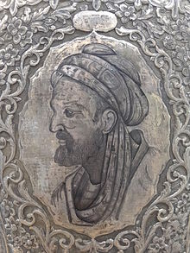
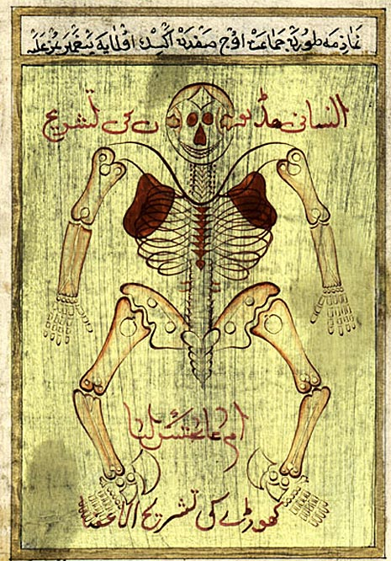
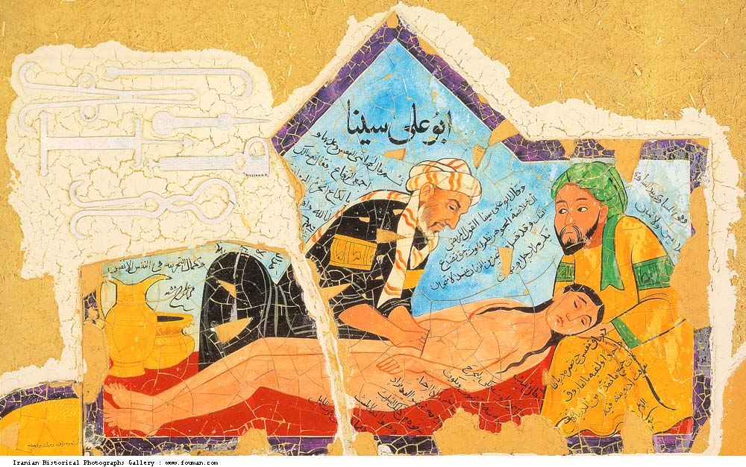
Ibn Senna (Avicenna)
980-1037

Slide 7
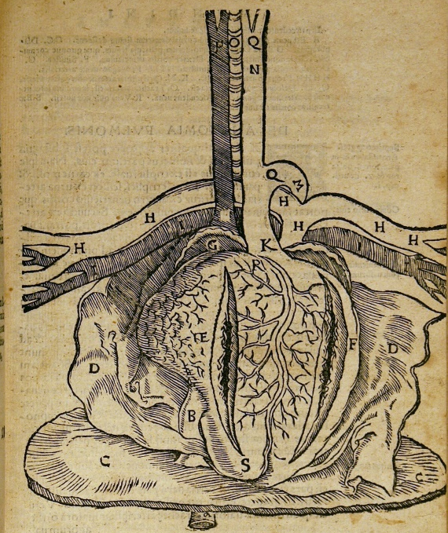
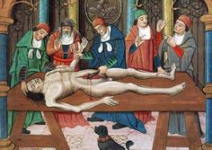
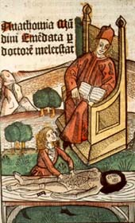
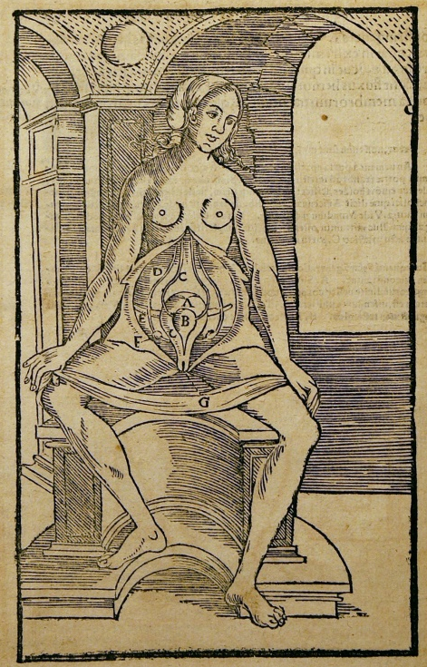
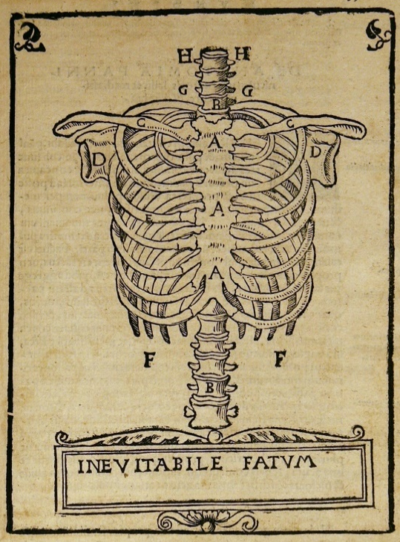
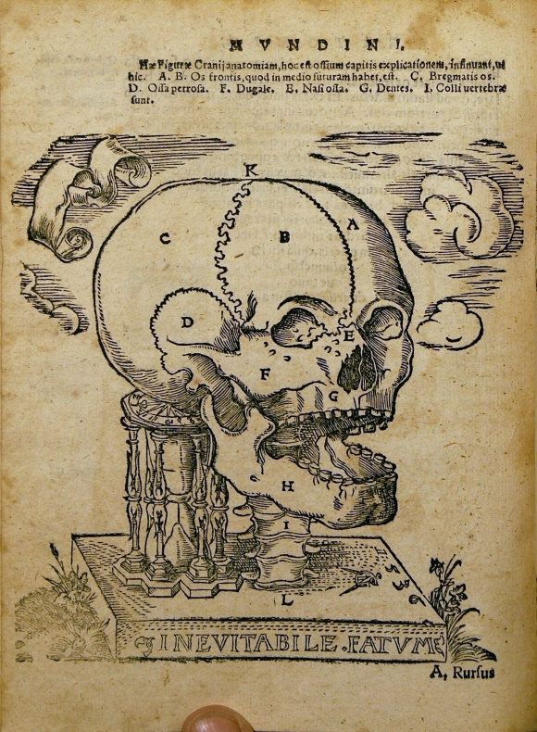
Mondino de Luzzi
(1276-1326).
Anathomia Corporis Humani

Slide 8
Renaissance.
Arts and Science come to life
At the end of the Middle Ages, Arts and Science had an incredible advance after the Scientific Revolution.
The invention of the printing press.
The development of perspective in art.
Human dissections to educate artists in the precise structure and musculature of the body.
Intellectual attitudes and empirical testing of theories by observation and experimentation.

Slide 9
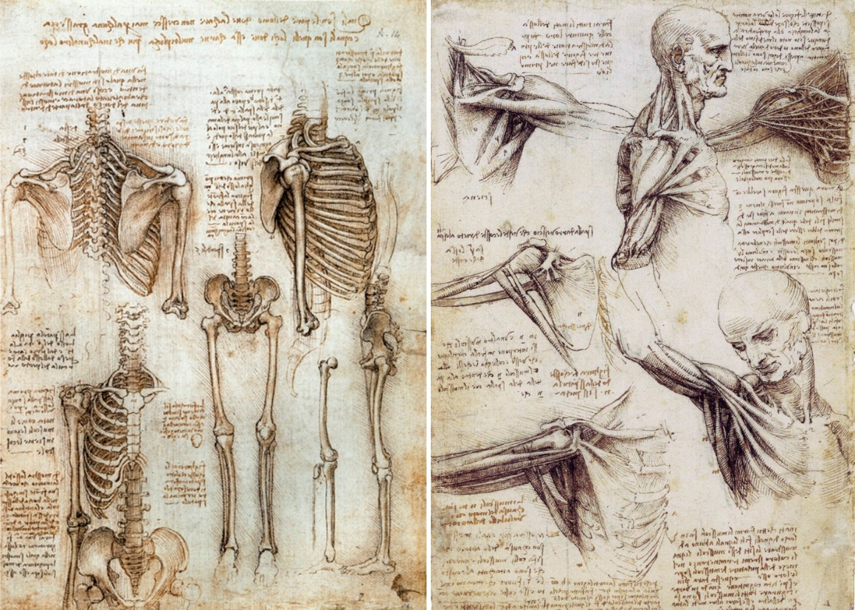
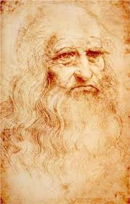
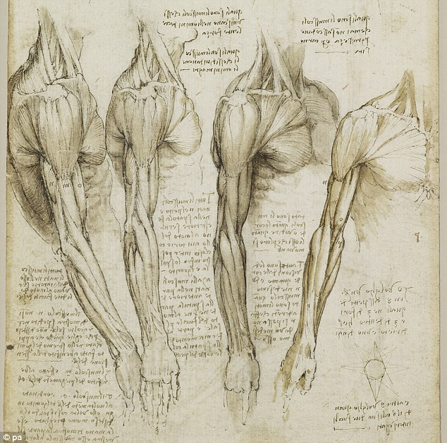
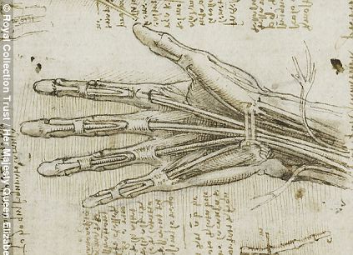
Leonardo Da Vinci
(1452-1519)

Slide 10
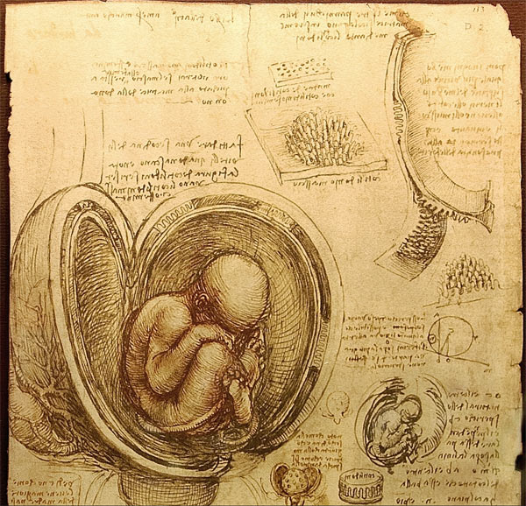
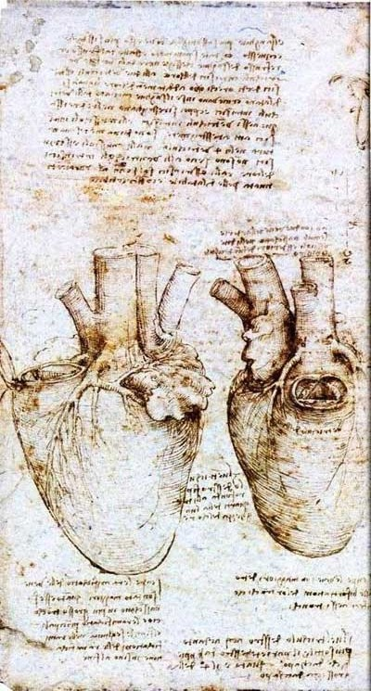
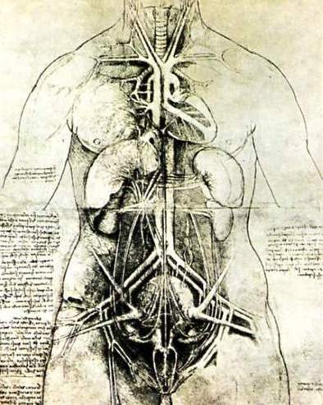

Slide 11
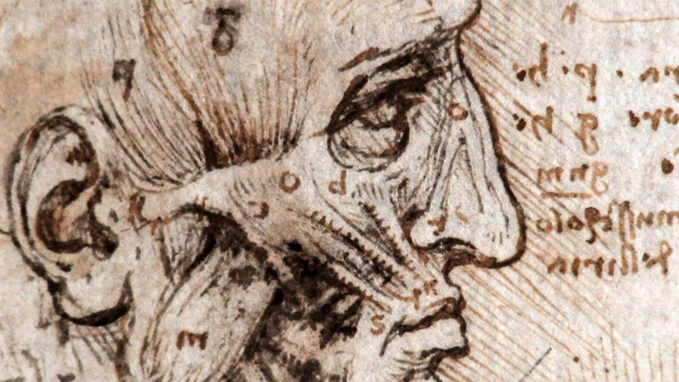
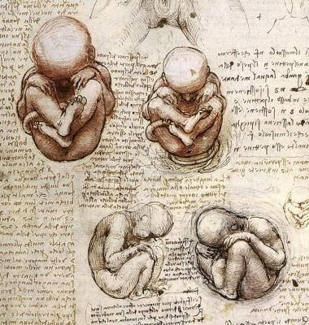
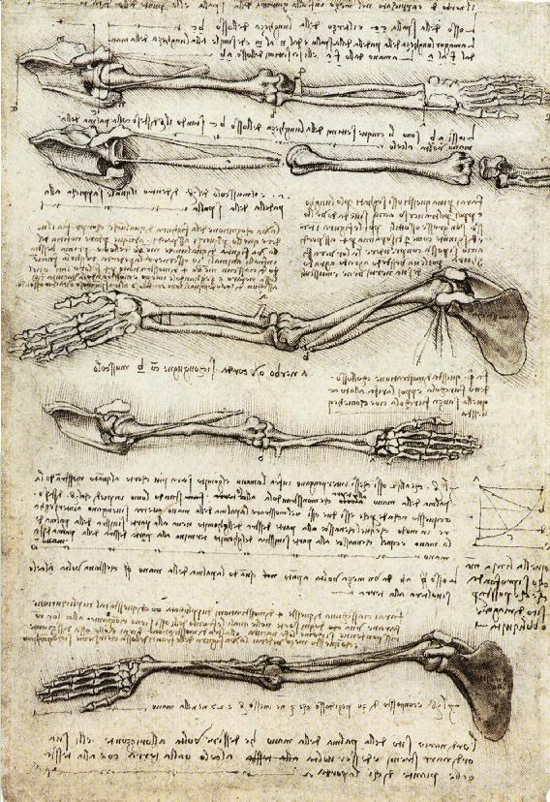
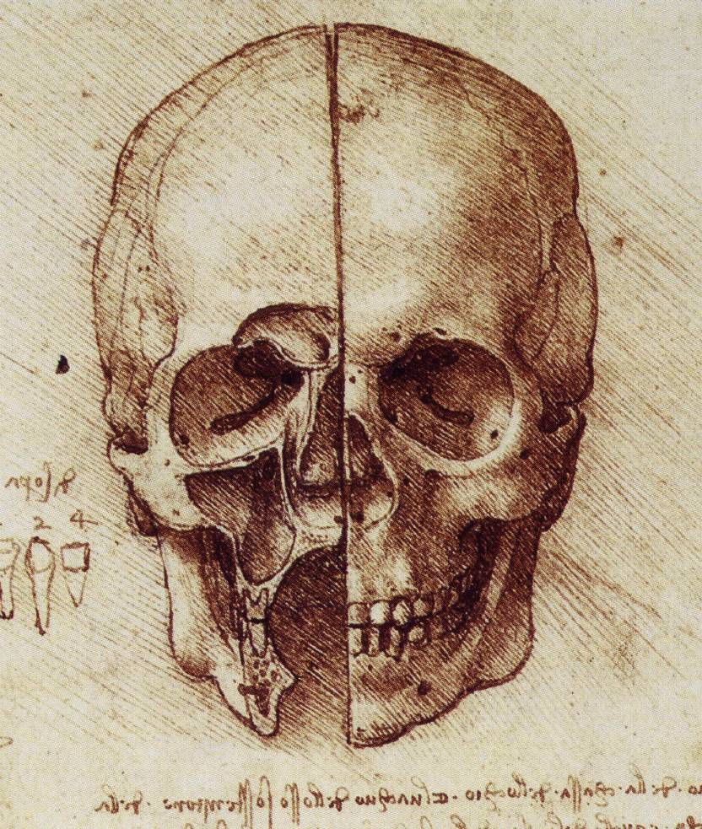
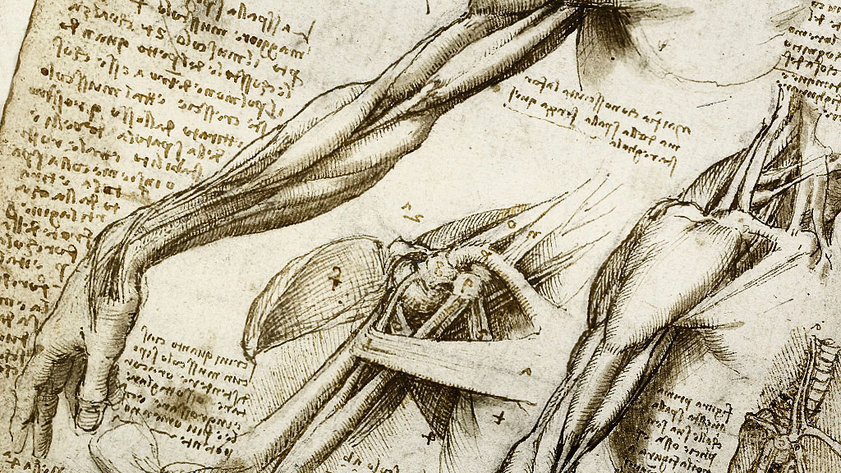

Slide 12
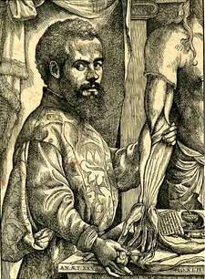
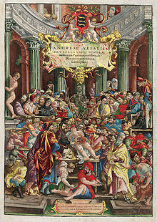
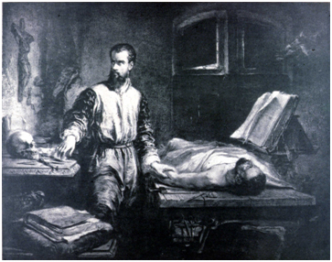
Andreas Vesalius
(1514-1564)
De Humani Corporis Fabrica

Slide 13
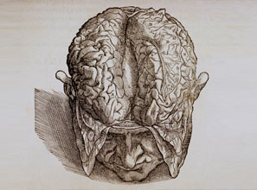
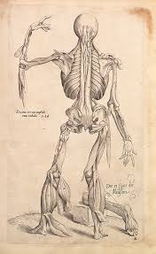
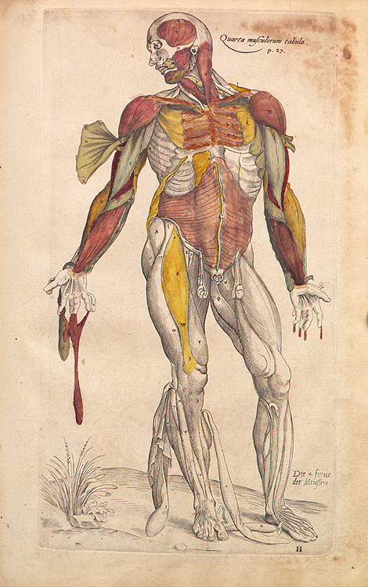
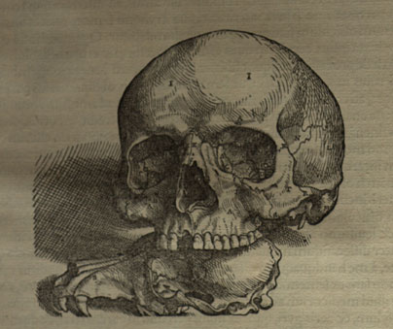

Slide 14
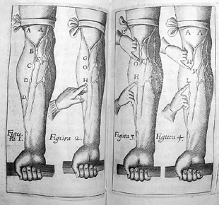
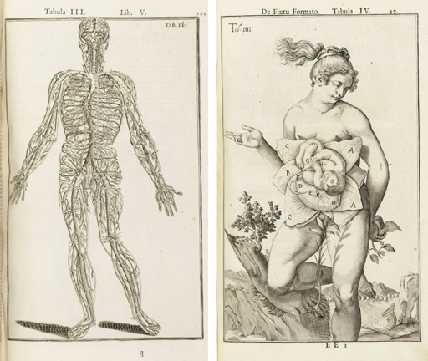
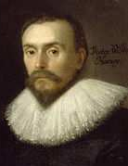

William Harvey
(1578-1657)
Anatomica de Motu Cordis

Slide 15






Henry Gray
(1827-1861)

