Slide 1
FORCES AND MOTION
Keep movin’ on…

Slide 2
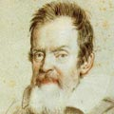
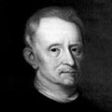
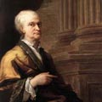
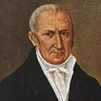
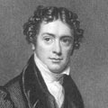
Interactions between matter and energy…
Physics is the field of Science that studies the interactions of matter and energy.
There are many important Physicists such as
GALILEO GALILEI | ROBERT HOOKE | ISAAC NEWTON | ALESSANDRO VOLTA | MICHAEL FARADAY | DEVELOPERS OF THE ATOMIC MODEL
ASTRONOMY | LAWS OF ELASTICITY | MECHANICS AND GRAVITY | ELECTRIC BATTERY | ELECTROMAGNETISM | JOHN DALTON J.J. THOMSON E. RUTHERFORD NIELS BOHR

Slide 3
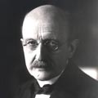
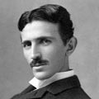
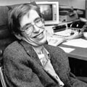
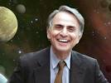
MAX PLANCK | NIKOLA TESLA | RELATIVITY AND QUANTUM THEORY | STEPHEN HAWKING | CARL SAGAN
QUANTUM THEORY | ALTERNATING CURRENT SYSTEM | ALBERT EINSTEIN WERNER HEISEMBERG ERWIN SCHRODINGER | BLACK HOLES | ASTROPHYSICIST

Slide 4
The Universe is in constant motion…
Isaac Newton stated the 3 Laws of Motion
Inertia: Objects tend to be in equilibrium. An object at rest, teds to be at rest, and an object in motion tends to be in motion. It is, the forces that affect them tend to be balanced.
F=ma. It is, force is the relation between mass and acceleration. It is, when the forces over an object are not balanced.
Action-reaction: For every action there is a reaction. It is, When a force is exerted on an object, there is an equal opposite force.

Slide 5
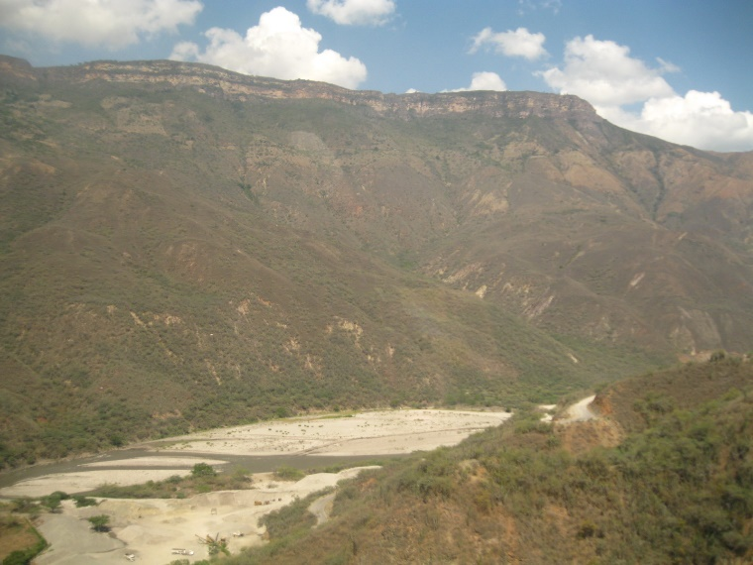
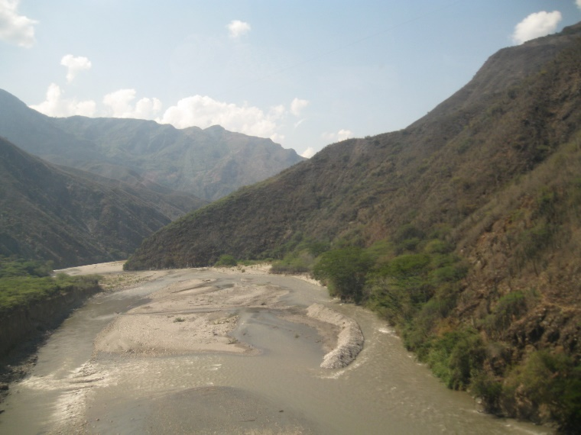
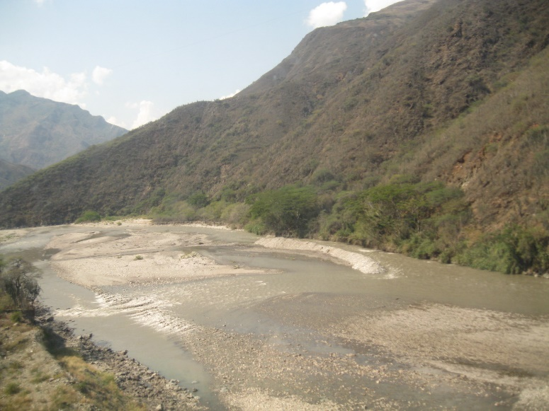
What is Motion?
Motion is any object's change in position relative to a reference point, it is, to an object that seems to stay in one place.
Example: A cable car crossing towards the Chicamocha canyon. You can tell the movement with the river as a reference point

Slide 6
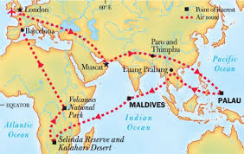
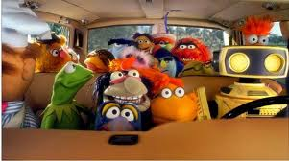
How can motion be shown?
Remember the Travel by map of the muppets?

Slide 7
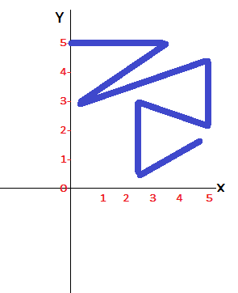
As you can see, motion is represented by a red arrow. The reference point, or origin is in London. A point should be set on each stop in the path.
This path can be represented in a grid, in which the axes provide a scale for distance.
An arrow that shows distance is called a vector.

Slide 8
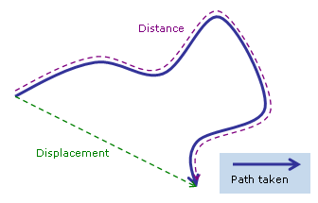
In physics, a change in position from its starting point to its end point is an object's displacement.
Displacement can be represented in the grid with arrows called vectors.
Distance is the path taken by the object.

Slide 9
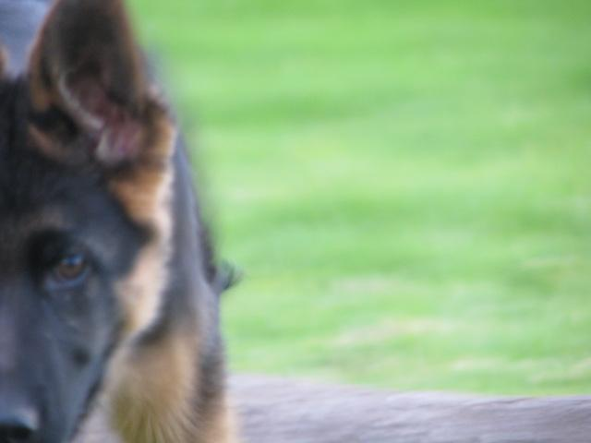
Example
Leo walks his dog Xucco every day. The park is 100 m east away from his house, and the park has 200 m x 200 m. He enters the park and walks 50 m east, then turns 80 m south, and finishes his journey 150 m west.
Use a grid to show the displacement and the distance.

Slide 10
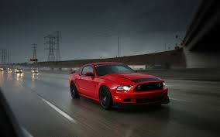
Velocity is defined as the rate at which an object changes position.
Speed is the distance traveled by an object divided by the time interval during which the motion occurred.
Speed can be constant or not. It is, sometimes an object can move at the same speed, but in most cases, speed can vary.
Speed can be calculated with the following equation:
Average speed= | Total distance (m)
 | Total time (s)

Slide 11
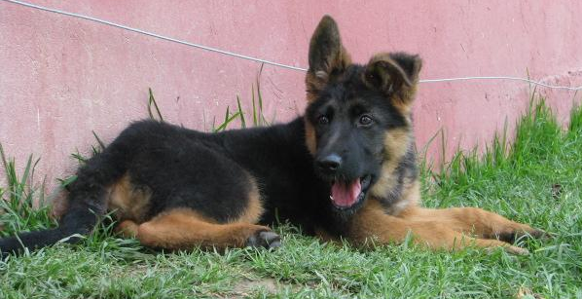
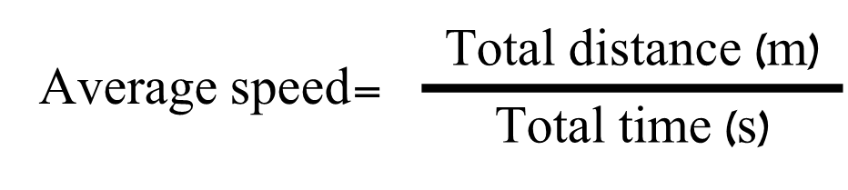
Example…
Leo walks his dog Xucco every day. The park is 120 m away from his house, and the park has 200 m x 350 m. If he takes 10:35 minutes to walk from his house to the park, enters and buys an ice cream during 2:15 minutes, and he spends 35:45 minutes walking around the park with Xucco, what is the average speed for the complete journey?
Use a ruler to draw the map.
Plot the distance traveled and the time spent in a line graph.
Use the formula to find the average speed.

Slide 12
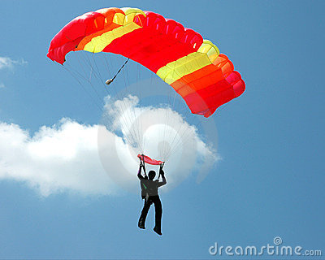
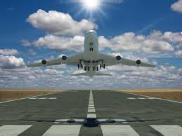
Acceleration
Is defined as the rate at which the velocity changes over time because of a change in its speed, direction or both.

Slide 14
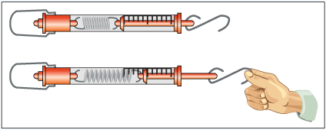
What’s a force?
A force is defined as the push or pull exerted on an object in order to change its motion. A force has a size and a direction.
Force is measured in Newtons. The apparatus to measure the size of a force is called a forcemeter.

Slide 15
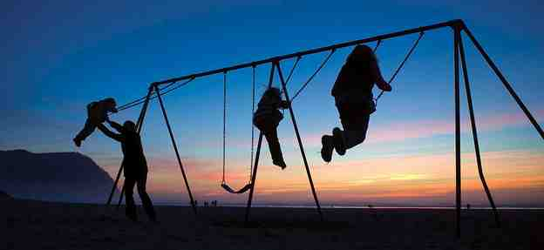
Different forces interact on objects such as gravity, weight, resistance, and so on, making the object to move or to stay steady.
Forces on an object are balanced when the object doesn’t move. It is, when the sum of the forces or net force that affect it is 0N.

Slide 16
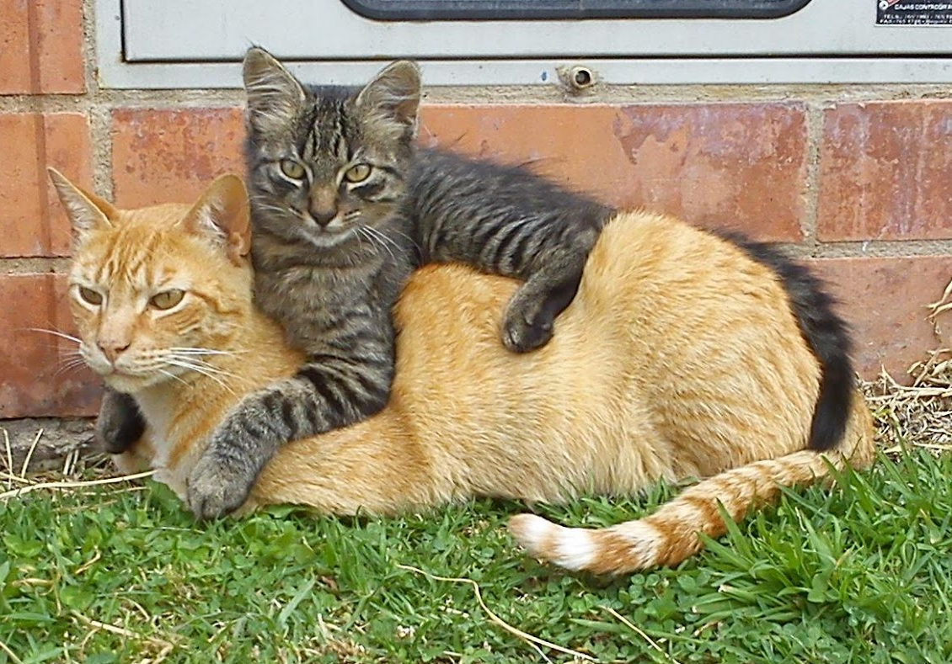
Gravity is the force of attraction between objects due to their mass and distance. It is the pulling force of Earth, or other space bodies over objects. The force of gravity on Earth is calculated as 9,8m/s². In some cases can be rounded to 10.
Gravity affects the mass of objects. Weight is the force exerted by gravity over an object. The most mass the object has, the heaviest it will be.
Weight is affected by gravity. You can find weight by multiplying mass and gravity.

Slide 17
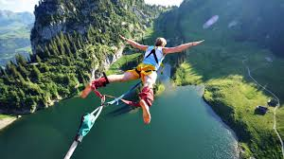
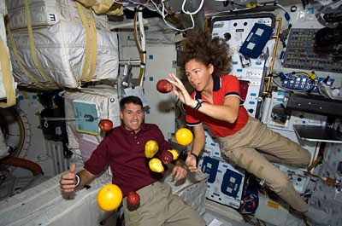
FREEFALL

Slide 18
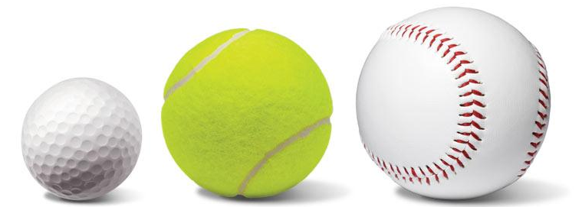
Think about it:
If you throw a paper ball and a golf ball simultaneously from the same height, which one falls first? What makes you think so?
Test by throwing a pencil and an eraser from your desk. Try by throwing different objects.

Slide 19
Galileo Galilei studied the rate of speed at which two objects fall.
Each second an object falls, it speeds up or accelerate at a rate of 9,8m/s² due to gravity.
Freefall is the motion of a body when only the force of gravity is acting on it.
To find the velocity of a falling object, you just divide the acceleration due to gravity (9,8m/s²) and the time the object takes to fall.
VELOCITY (Vf)= | 9,8m/s²
 | TIME (s)

Slide 20
Example
Use your ruler to measure the height of your desk.
Choose two different objects from your pencil case.
Drop each object and measure the time it takes for each object to reach the floor.
Use the formula to calculate the final velocity of each object.
VELOCITY (Vf)= | 9,8m/s²
 | TIME (s)

Slide 21
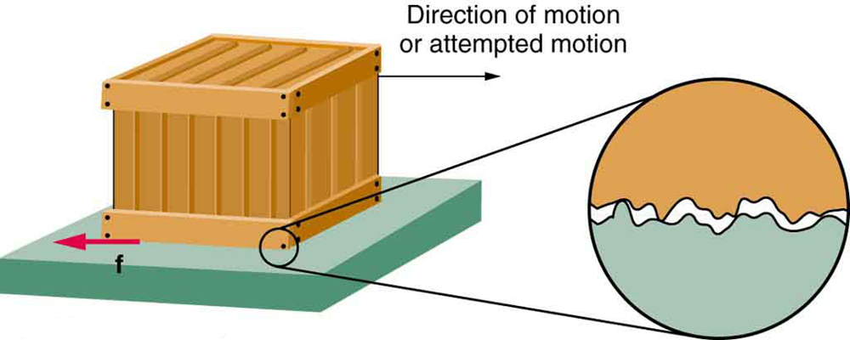
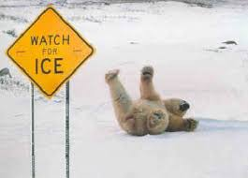
Friction is a force that opposes the motion between two surfaces that are in contact.
Friction is caused by the roughness of the surfaces that are in touch. No matter how much smooth an object feels, it has tiny hills and valleys that are going to cause friction.

Slide 22
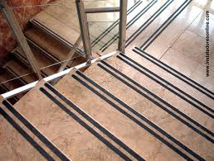
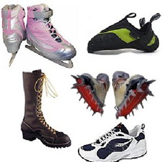
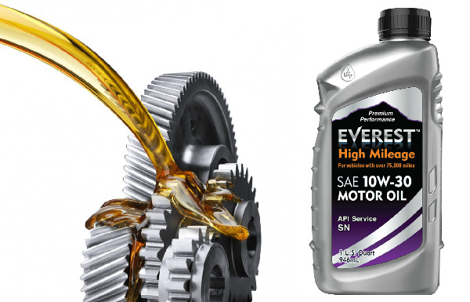
Friction can be increased as the surfaces get rougher.
Example: Some stairs in public places have a line of a rough material to increase friction, so people cannot slip and fall through them.
Friction can be decreased as the surfaces get smoother by applying lubricants.
Example: Wax is applied at bowling lines to make them smoother. Oil is applied to some parts of engines to soften the rubbing movement.

Slide 23
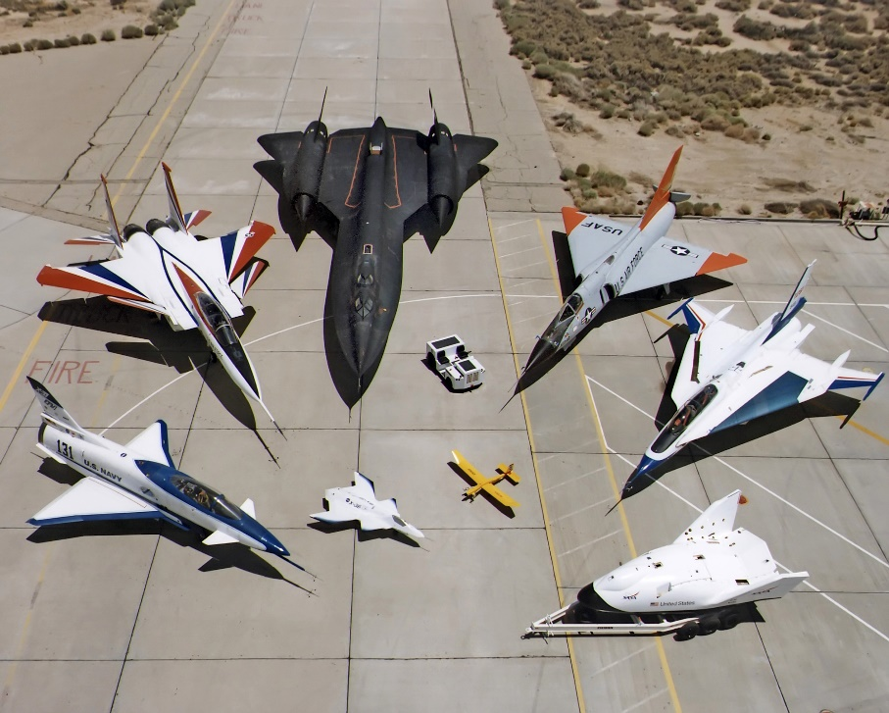
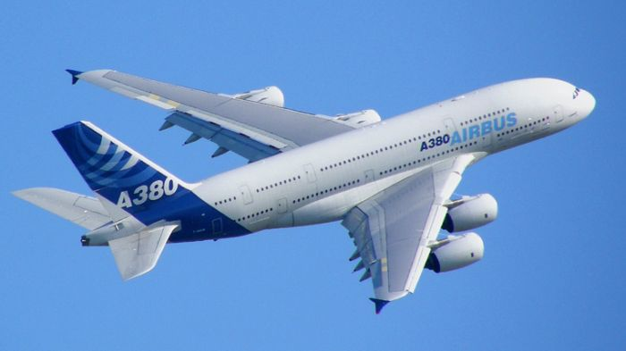
Resistance is the tendency of a material to resist the flow of a current
Air and water exert resistance to objects moving towards them. It will be affected by the shape, the size and the speed of the object.
A Streamline design is a shape that offers the least resistance to fluid flow.

Slide 24
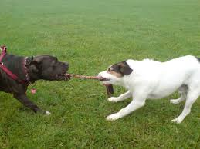
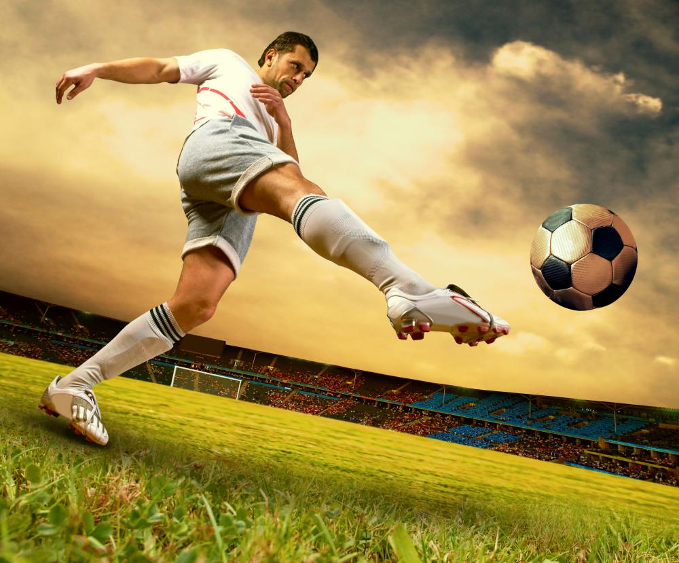
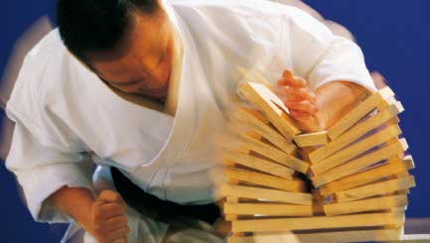
Momentum is the product of the mass and velocity of an object. This may explain why a compact car and a truck will pull over at different times though they have the same velocity, or why a fat person will fatigue first than a thin person when walking.

Slide 25
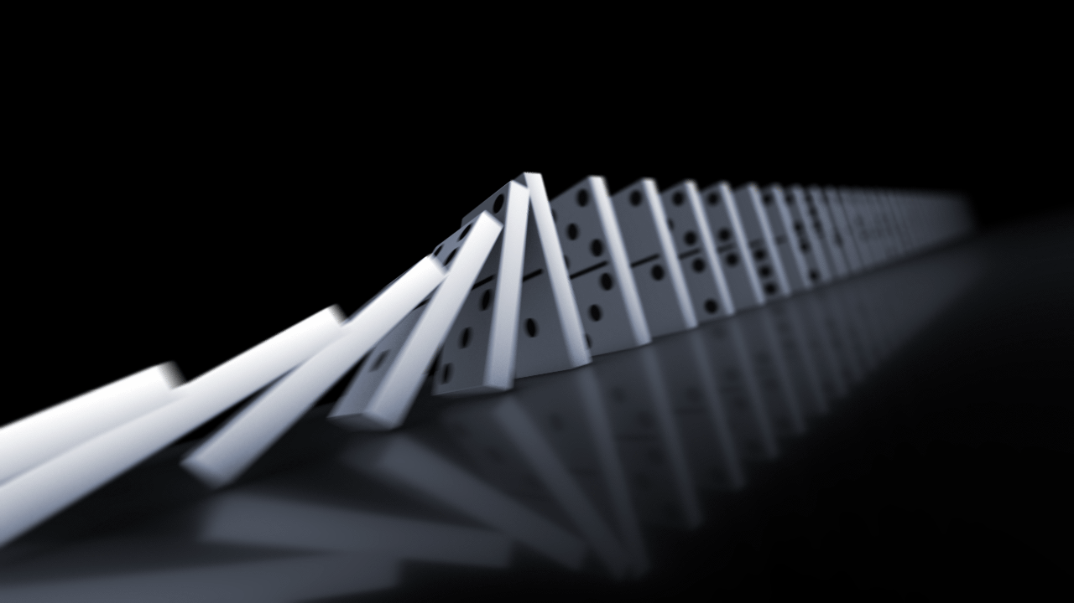
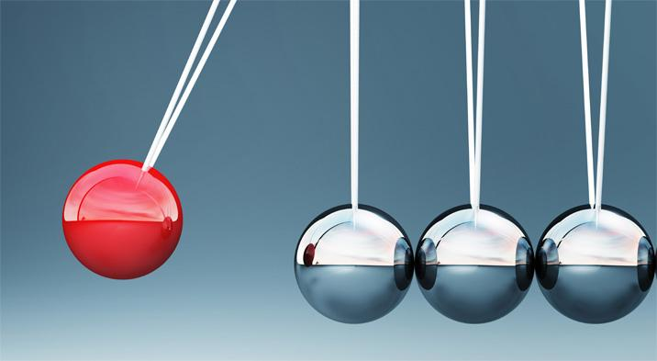
Momentum can be expressed as
MOMENTUM (p)=MASS (Kg) x VELOCITY (m/s)
When an object hits another, the momentum of the first object is partially or totally transferred to the other object. This is the Law of Conservation of Momentum. That’s why a ball moves when you kick it.

