Slide 1
Electron Configuration
Is the representation of the arrangement of electrons distributed among the orbital shells and subshells within an atom.

Slide 2
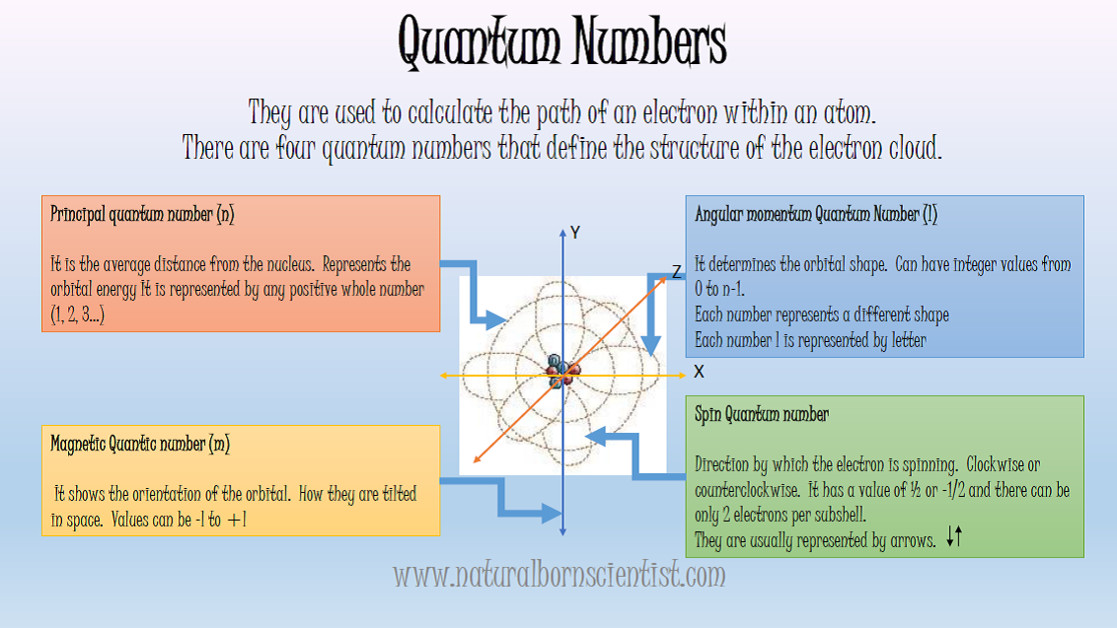
Remember the quantum numbers?

Slide 3
Quantum Numbers in the Periodic Table

Slide 6
The electron configuration is given by the following rules:
Aufbau Principle
Aufbau comes from the German word "Aufbauen" which means "to build". In essence when writing electron configurations we are building up electron orbitals as we proceed from atom to atom. As we write the electron configuration for an atom, we will fill the orbitals in order of increasing atomic number.

Slide 7
Pauli Exclusion Principle
In an atom, no two electrons can have the same four electronic quantum numbers. We are aware that in one orbital a maximum of two electrons can be found and the two electrons must have opposing spins. That means one would spin up (+1/2) and the other would spin down (-1/2).

Slide 8
Hund's rule
Every orbital in a sublevel is singly occupied before any orbital is doubly occupied. All of the electrons in singly occupied orbitals have the same spin (to maximize total spin). When assigning electrons to orbitals, an electron first seeks to fill all the orbitals with similar energy before pairing with another electron in a half-filled orbital.

Slide 9
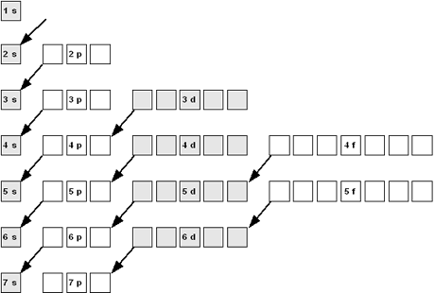
There are three ways of writing the electron configuration:
Orbital diagrams:
According to the Aufbau and Hund’s rule, each level will fill one electron at a time until all the orbitals are full. In this diagram, you can also see the exclusion principle as you represent the electrons as vertical arrows pointing on opposite directions.

Slide 10
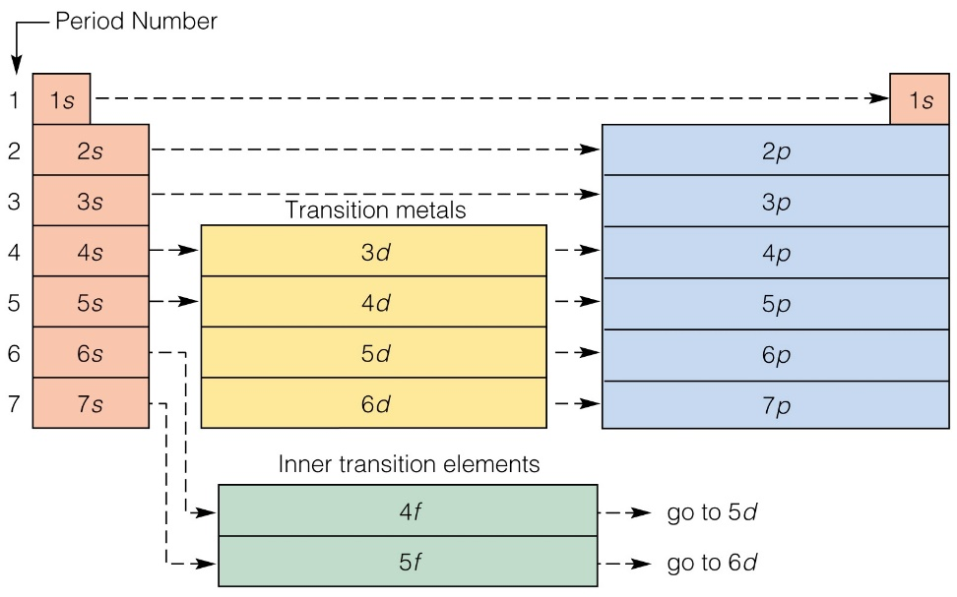
Using the periodic table:
The periodic table is arranged according to the energy levels and sublevels. As you go through the periods in the periodic table, you will notice how the atomic number increases and how each level is filled.

Slide 11
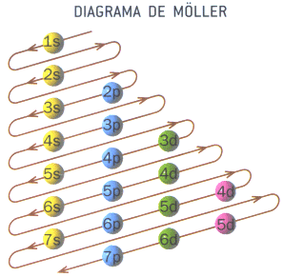
Möeller Diagram:
It is a structure that guides you through the sublevels and indicates the energy levels and numbers of electrons on each one. By guiding yourself with the atomic number, you just follow the arrows counting the superscripts until you reach the value of the atomic number of the given atom.

Slide 12
Thanks for your attention!!
REFERENCES:
http://chemwiki.ucdavis.edu/Inorganic_Chemistry/Electronic_Configurations
http://kaffee.50webs.com/Science/images/electronic_config2.JPG
http://www.gobiernodecanarias.org/educacion/3/usrn/lentiscal/1-cdquimica-tic/applets/configuracionelectronica-1/imagenes/DiagramaMoller.gif
BURNS, Ralph A. Fundamentos de Química. Pearson Educación, 2003.

