Slide 1
Periodic Properties
What Mendelieev, Lothar Mayer and others noticed…

Slide 2
The importance of the Atomic Number
The atomic number is given by the amount of protons within an atom. At the same time, we can say that it stands for the number of electrons as well.
This number is going to determine different properties for the atom, because protons and electrons have opposite electric charges, and electrons are organized in energy levels and shells (orbitals)

Slide 3
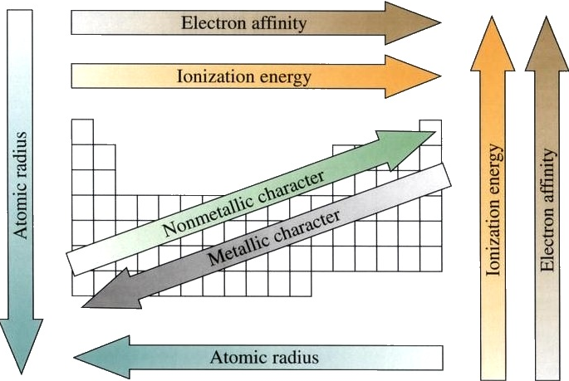
The periodic properties change towards the periodic table.

Slide 4
Metallic character
Includes the ability of losing electrons. The plasticity of their valence electrons gives them their characteristics:
High melting points and densities.
Large atomic radii.
Low ionization energy and electronegativity.
Malleable and ductile.
Energy conductors.
It decreases from left to right and increases from top to bottom.

Slide 5
Non-metallic character
High ionization energies and electronegativity.
Poor energy conductors.
Gain electrons easily.
Brittle solids.
Little or no luster.

Slide 6
Electron Affinity
Is the tendency of an atom of a certain element to catch electrons.
Non-metals are usually electron acceptors or electronegative.
Metals are givers or electropositive.
Electronegativity increases from left to right within a period, and from bottom to top within a group.

Slide 7
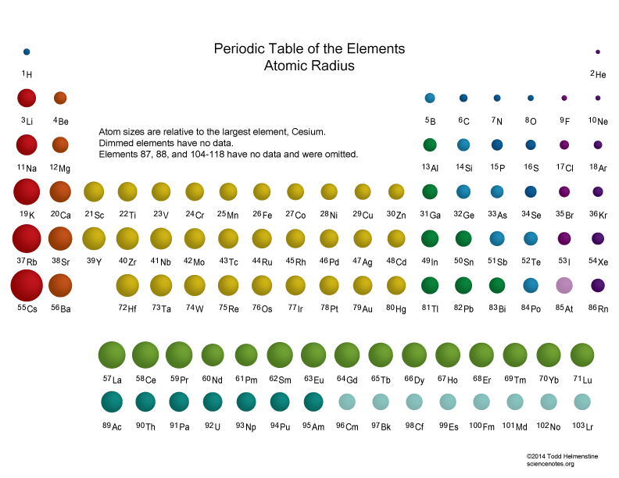
Atomic Radius
Is the distance from the center of the nucleus to the most external electron.
The Atomic radius decreases from left to right and increases from top to bottom.

Slide 8
Ionization Energy
Is the energy needed to remove an electron from an atom in a neutral gas state.
It increases from bottom to top in a group and from left to right in a period, because, the most electrons, the most protons, so more attraction.
Metals tend to form positive ions or cations.
Non-metals tend to form negative ions or anions

