Slide 1
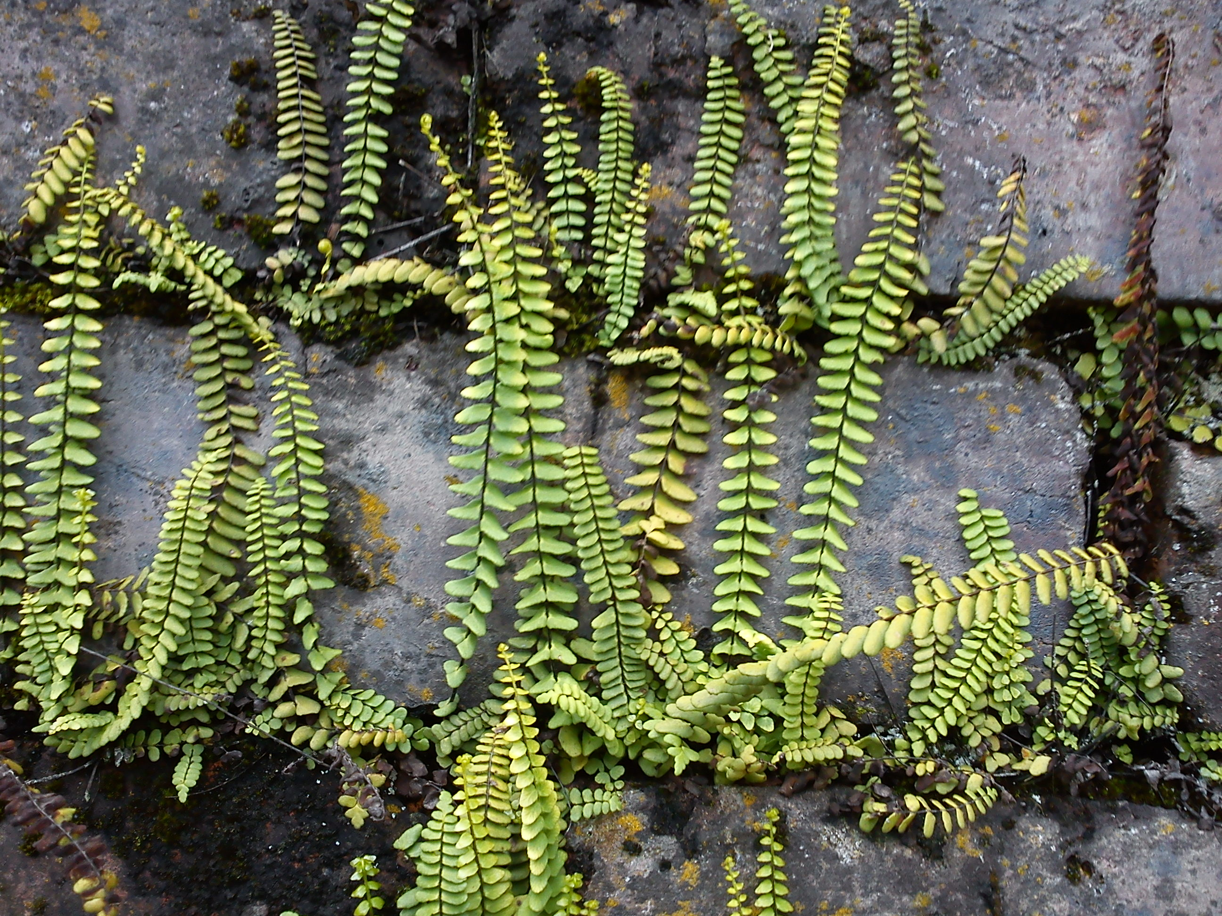
PLANT TISSUES
How is the internal organization of a plant?

Slide 2
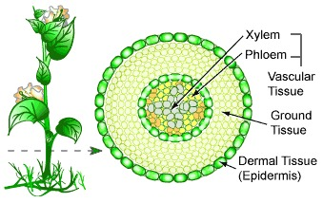
“ORGAN” SYSTEMS IN PLANTS
As many organisms, the cells of a plant are organized in tissues that can be made of a single type of cell, or complex made of different types of cells. The tissues of plants are organized in systems. These systems are dermal tissue, ground tissue and vascular tissue.

Slide 3
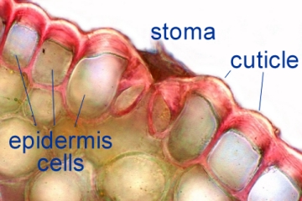
DERMAL TISSUES
The dermal tissues system consists of the epidermis that is a single layer of cells that protects and covers the plant. It secretes a waxy substance called cuticle and it usually have guard cells and stomata. The periderm that replaces epidermis when the plant undergo secondary growth is made of cork cells, phelloderm and phellogen (cambium)

Slide 4
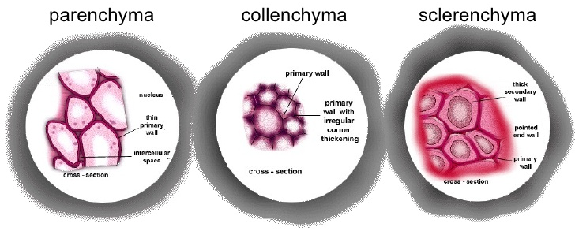
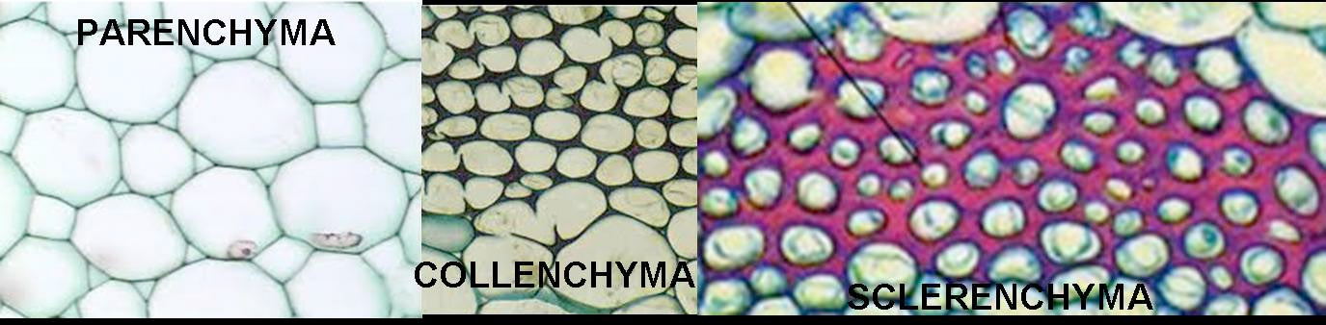
GROUND TISSUES
The ground tissues system synthesizes organic compounds, supports the plant and stores substances. It is made of a soft tissue called parenchyma that synthesizes and stores organic molecules, collenchyma that helps in supporting the plant, and sclerenchyma that are more rigid than collenchyma.

Slide 5
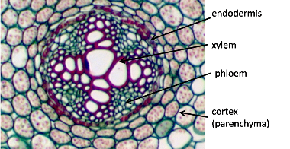
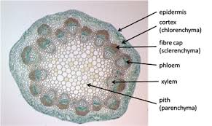
VASCULAR TISSUES SYSTEM
The vascular tissues system is made of two kinds of vessels: Xylem that is made of nonliving tube-like structures called tracheids and vessel elements that transport water and minerals from the root to the plant; and phloem that is made of living cells called sieve-tube cells and companion cells that transport the substances provided by photosynthesis from leaves to other parts of the plant.

Slide 6
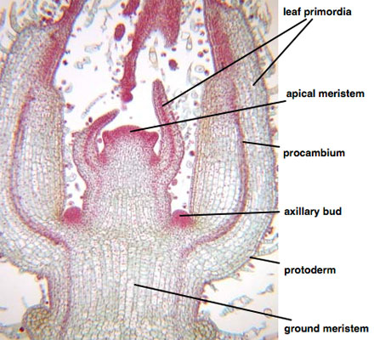
GROWTH TISSUE
The growth tissue of the plant is called meristem. Meristemic cells can develop into different kinds of plant cells according to the plant needs. They are the “stem cells” of plants and they are constantly undergoing mitosis. It is usually found at the tips of shoots and roots and at the apex of stems (apical meristems), and in the cambium and phellogen (lateral meristems)

