Slide 1
CHICKEN WING DISSECTION
HOW A CHICKEN WING IS SIMILAR TO A HUMAN ARM?

Slide 2
OBJECTIVE: TO DESCRIBE HOW BONES AN MUSCLES WORK TOGETHER TO PERFORM A MOVEMENT ACCORDING TO THE ADAPTATIONS OF THE ORGANISM.
PROCEDURE
Using the dissection tools, try to remove the skin of the wing. Be careful not to break or cut any underlying structure.
Make a drawing of the complete exposed area. Identify and label each part.

Slide 3
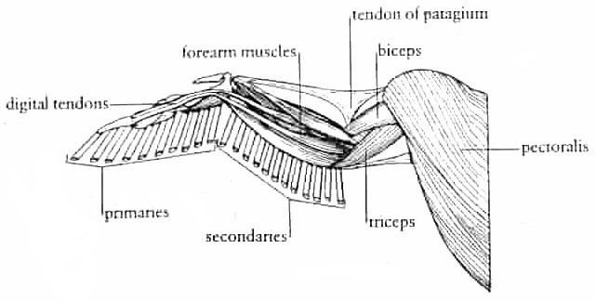
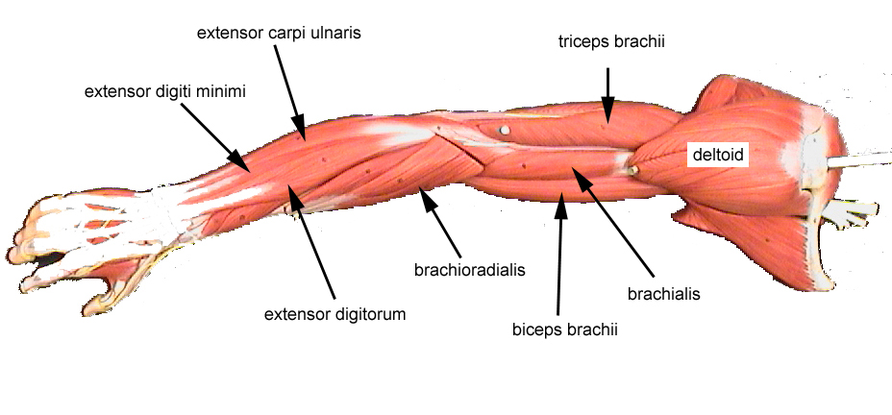
3. Compare the wing with the drawing of the human arm.
4. Locate the muscles of the wing and gently tug each one. Observe and record what happens to the rest of the wing when you tug. Make a drawing.
5. Observe how the pack of muscles are attached to the bones.

Slide 4
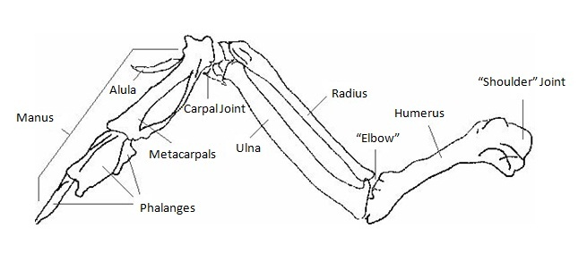
6. Remove the muscles to expose the bones. Draw another diagram labeling the bones.

Slide 5
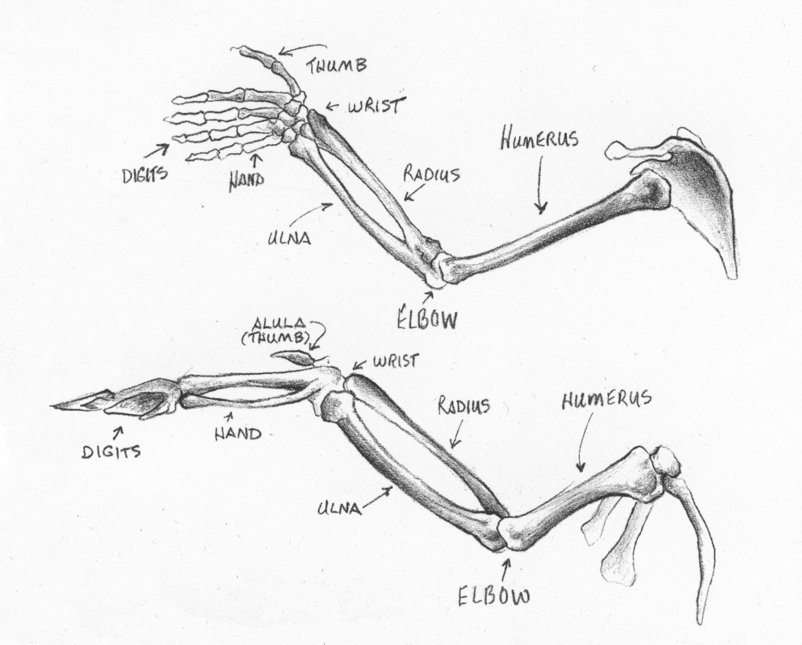

Slide 6
EXTRA ACTIVITY
1. How do muscles interact to perform a movement?
2. Compare and contrast tendons and ligaments.
3. What are the functions of the muscular system in mammals?
4. Compare and contrast the three kinds of human muscle.

